Slide 1
All (or most of) the Astrolabes
By Dr. Harold Alden Williams, Director of the Universarium at Montgomery College Takoma Park/Silver Spring Campus, Montgomery County Maryland, United State of America, Planet Earth, around Helios/Sol/Sun star, in the Milky Way Galaxy, and outlying galaxy of the Virgo Supercluster in Lanakiya

Slide 2
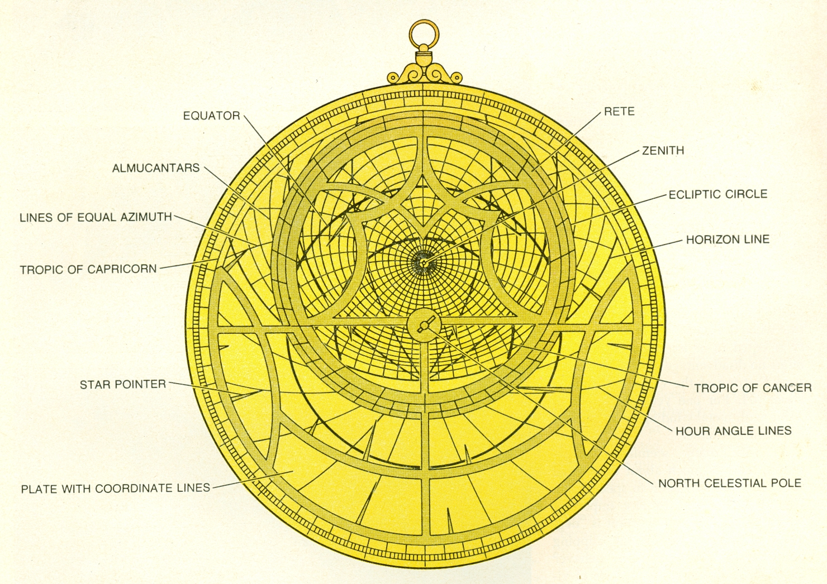
Plainspheric
Astrolabe

Slide 3
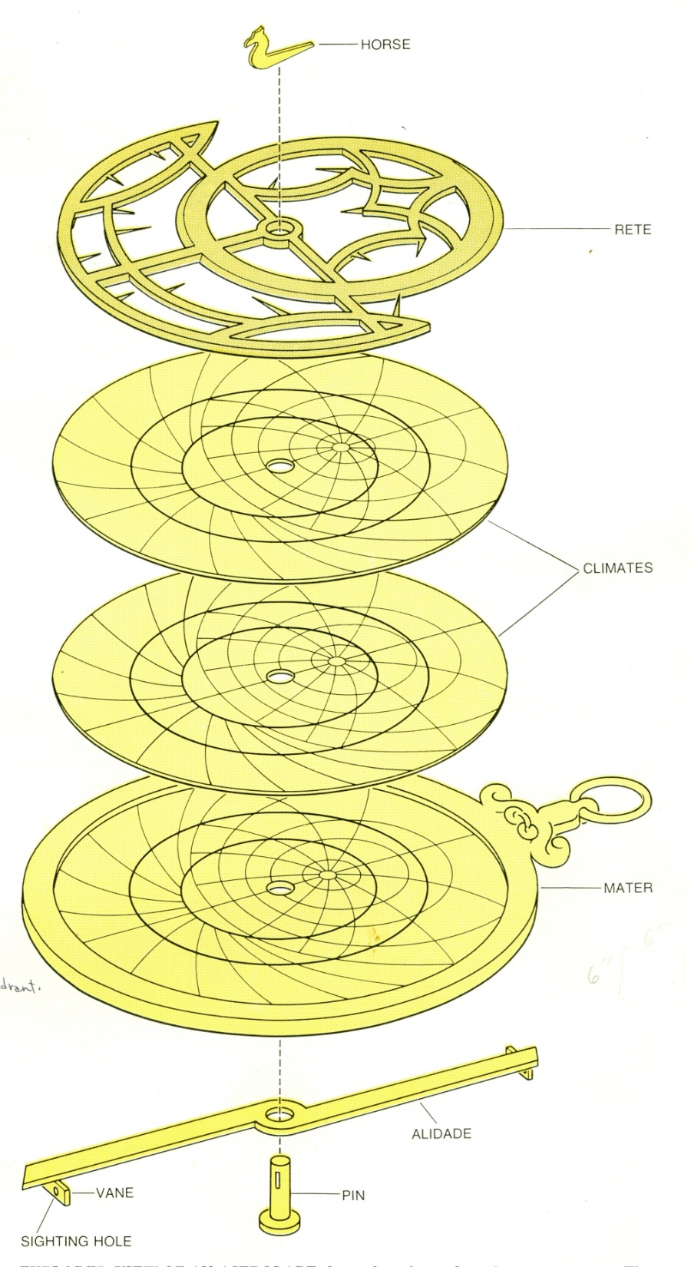
Parts
Rete or net, a star map
Climate or Typanium, latitude specific

Slide 4
Part of the Astrolabe
Rete, net in Latin, the star map, off axis circle the ecliptic (the zodiacal signs)
Plates (climate or tympanum), latitude specific, horizon coordinate system, altitude and azimuth
Notes:
Picture from North, J. D., “The Astrolabe”, Scientific American, 230:1, 96-106 (January, 1974)

Slide 5
Stereographic Projection of Rete
For a rete to represent the Northern hemisphere
Notes:
North, J. D., “The Astrolabe”, Scientific American, 230:1, 96-106 (January, 1974)

Slide 6
Janus astrolabe rete

Slide 7
Rete for 2800BCE

Slide 8
Rete for 500BCE

Slide 9
Rete for 140

Slide 10
Rete for 2000

Slide 11
Rete for 13400

Slide 12
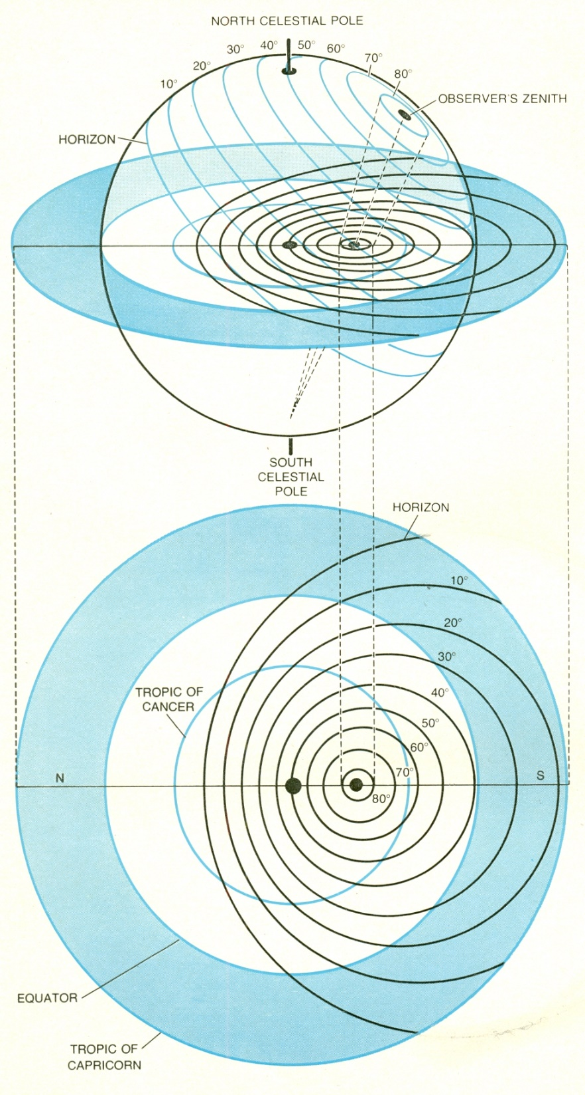

Slide 13
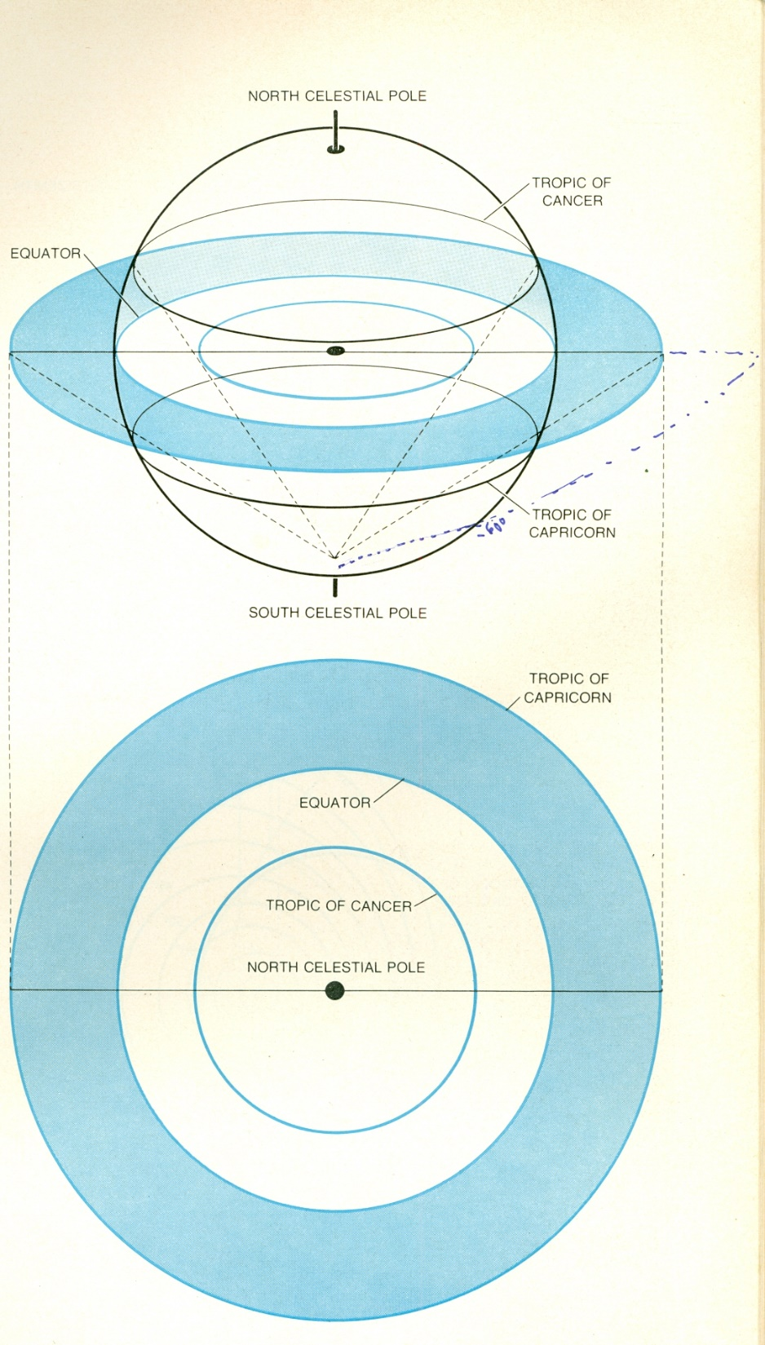

Slide 14
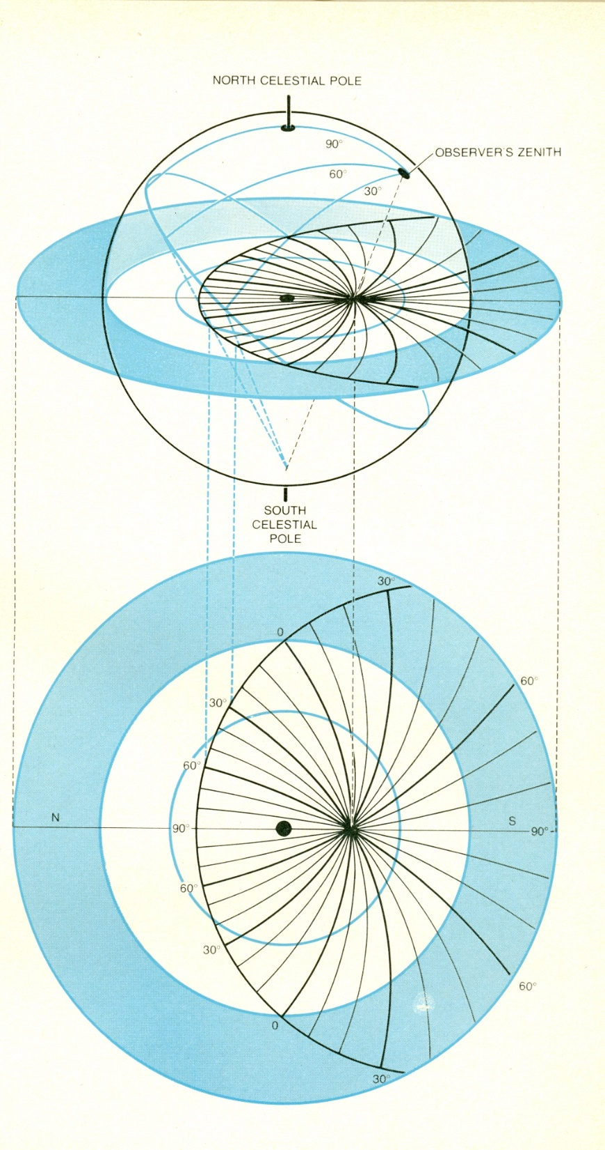

Slide 15
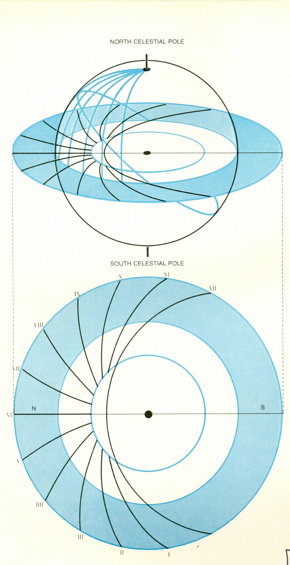

Slide 16
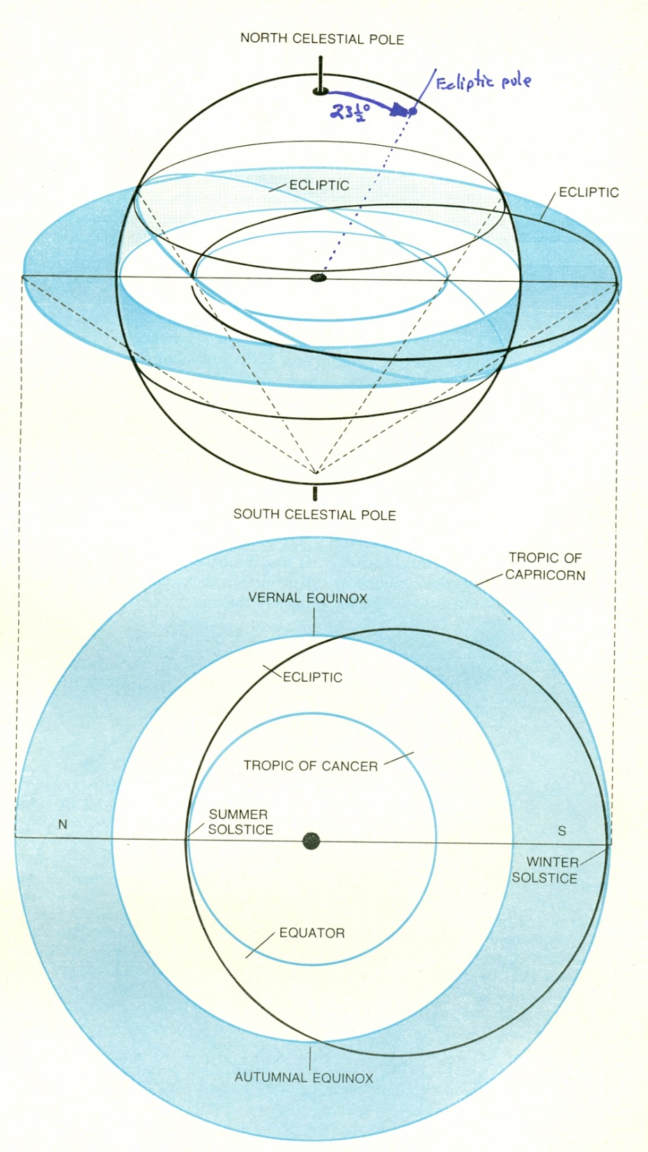

Slide 17
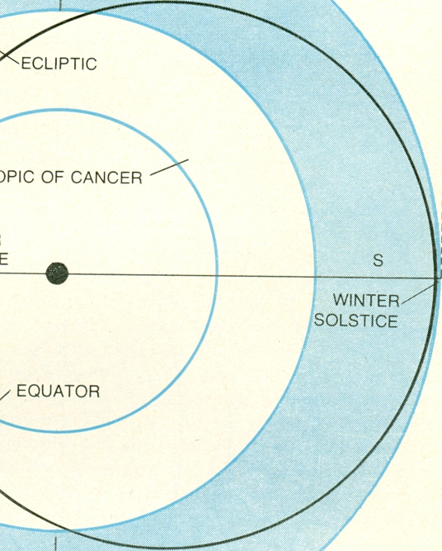

Slide 18
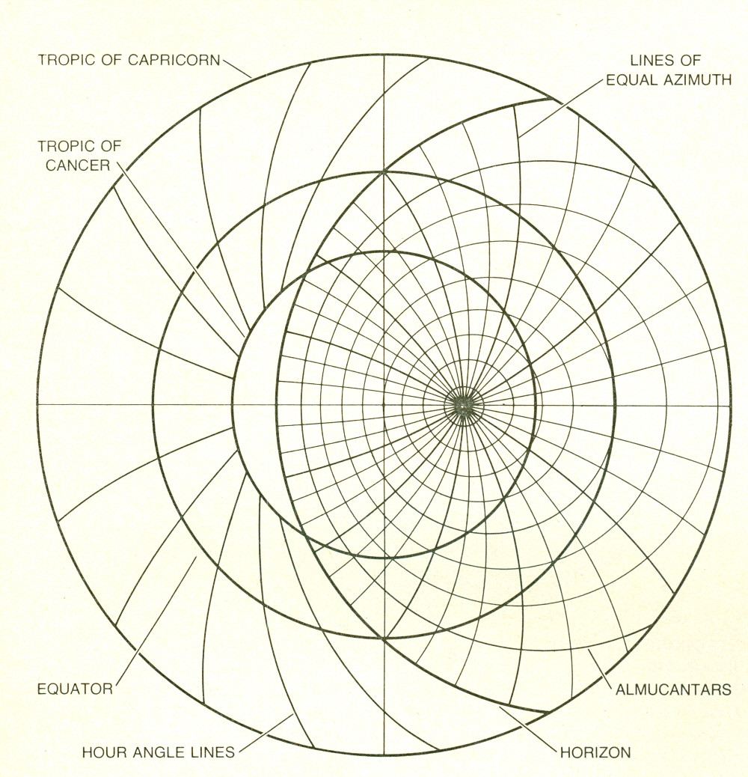

Slide 19
Hour angle Projections
Notes:
North, J. D., “The Astrolabe”, Scientific American, 230:1, 96-106 (January, 1974)

Slide 20
Climate for 25 degrees

Slide 21
Climate for 30 degrees

Slide 22
Climate for 35 degrees

Slide 23
Climate for 40 degrees

Slide 24
Climate for 45 degrees

Slide 25
Climate for 50 degrees

Slide 26
Climate for 55 degrees

Slide 27
Climate for 60 degrees

Slide 28
Plate for 0 and 90 degrees

Slide 29
Plate for ecliptic transformation

Slide 30
Plate for all horizons in 5 degree increments, used to cast horoscopes for people born at latitudes that you do not have a climate for. It allows you to get ascendant and descendent signs of the zodiac for their birthdate.

Slide 31
Back of astrolabe
Highly variable
But most had calendar and zodiac
& angle measuring protractor
Notice perihelion and aphelion and center of calendar & zodiac, do not have the same center, this is because of the earth’s slightly elliptical (non-circular orbit).
Notes:
The shadow square was used for simple surveying such as finding heights, depths and distances. The object under investigation (such as the top of a tower) was sighted using the alidade. The needed ratio of height or distance (the tangent of the angle) was read on the shadow scale.
Old astrolabes had many other scales on the back depending on where and when an instrument was made. Many Islamic instruments had scales for finding the direction to Mecca (qibla) and mathematical scales for finding sines and cosines. Some instruments had special scales for finding prayer times. European astrolabes had no need for the elaborate Islamic scales and often had only a scale for converting between equal and unequal hours or no additional scales at all.

Slide 32
Plate (climate or tympanium)
Altitudes or almucanters
Twilight Arcs, -6º Civil, -12º Nautical, -18º Astronomical
Azimuths
North 0º & 360º
East 90º
South 180º
West 270º

Slide 33
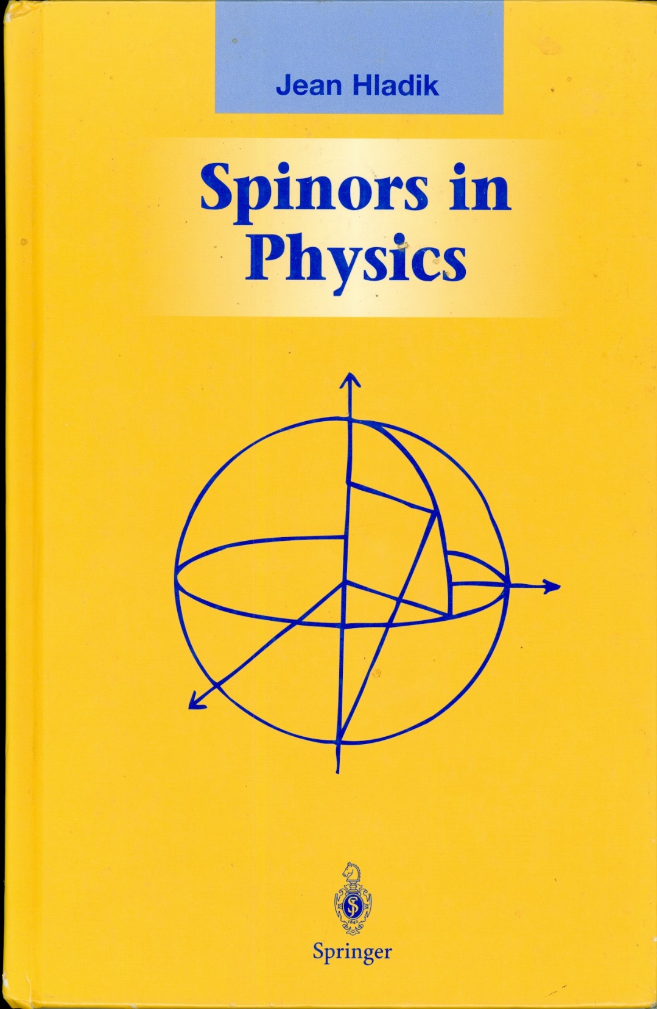

Slide 34
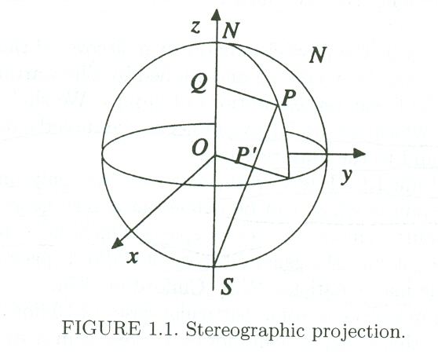
Same mathematical projection for astrolabes and spinors

Slide 35
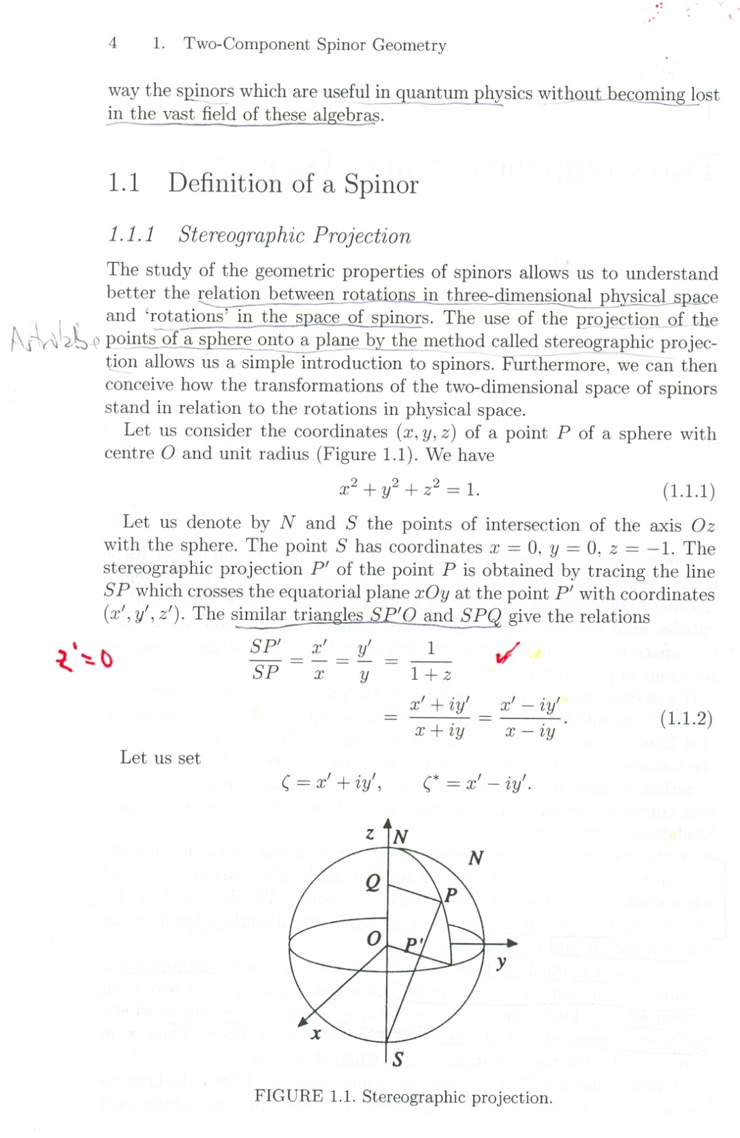

Slide 36
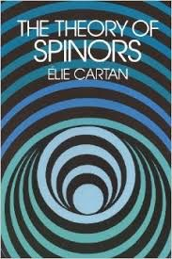

Slide 37
The Theory of Spinors by Elie Cartan Topics Spinors, Dirac, Minkowski, Riemann, Special Relativity
https://archive.org/details/TheTheoryOfSpinors

Slide 38
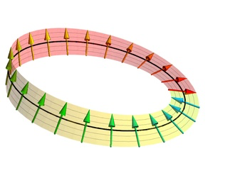

Slide 39
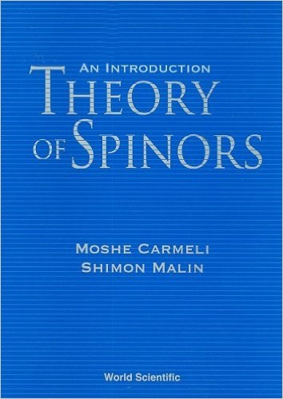

Slide 41
Recently made Islamic Astrolabe
Dr. Hasan Bilani, University of Aleppo, Syria November 2000
It is not a reproduction of a specific instrument but is in the style of a typical, high quality Islamic astrolabe.
It was designed using AutoCAD and was engraved by chemical milling.
It required about two months to manufacture. It is made of brass and is about eight inches in diameter and 5.5 mm thick and weighs 900 gm. There are 23 stars precessed to the current epoch. There are six plates provided but only two can but only two can be held in the mater at a time. The quote from the Koran on the throne (kursi) is "…and by the stars (men) guide themselves".

Slide 43
Rete, Persian astrolabe made in Tuse around 500 years ago. Arabic (antiques script and Pharsi markings.
Notes:
Rete of Wheeler astrolabe

Slide 44
Matter
Notes:
Wheeler astrolabe, bought in 1996 by Andy Wheeler, MC alumnus, and Bectel Corporation Executive in Kochin in Karala State, South India. 29 centimeters across, 11 ½ Regan inches. 2 climate plates for different latitudes, 1 plate of horizons for astrology, 1 plate for 0 & 90 degrees and 1 plate for ecliptic coordinate conversion. 1142 H.G. date is this 1729AD? Evidently made in Tuse a ruined city out side of Mashid in Iran today.

Slide 45
Climate or tympanum, 1
Notes:
Wheeler astrolabe

Slide 46
Climate or tympanum, 2
Notes:
Wheeler astrolabe

Slide 47
Climate or tympanum, 3
Notes:
Wheeler astrolabe

Slide 48
Horizons Plate for casting Horoscopes
Notes:
Wheeler astrolabe

Slide 49
Notes:
18th Century Persian Astrolabe from the Whipple Museum of Science

Slide 50
Notes:
Andalusia astrolabe

Slide 51
Astrolabes in Islam references
Islamic astronomy http://en.wikipedia.org/wiki/Islamic_astronomy
Muslim astronomers http://en.wikipedia.org/wiki/Muslim_astronomers

Slide 52
Some Islamic Astronomers
Abd Al-Rahman Al Sufi (December 7, 903 – May 25, 986) http://en.wikipedia.org/wiki/%27Abd_Al-Rahman_Al_Sufi Amazing treatise of 386 chapters presenting 1000 uses of the astrolabe

Slide 53
Astrolabes reaching the West
Gerbert of A’urillac, Gerbert d'Aurillac, Pope Silvester II, (ca. 950 – May 12, 1003) http://en.wikipedia.org/wiki/Gerbert_of_Aurillac

Slide 54
First Astrolabe I ever made. Notice it has the complete horizon, this is unusal on plain sphere astrolabes.
Notes:
Idea from Experiments in Astronomy for Amateurs by Richard Knox St. Martin’s Press NYNY copyrighted 1976

Slide 55
Second astrolabe I had a draftswomen do

Slide 56
Fred Whitle, a fellow graduate student’s astrolabe
Notes:
Notice that the climate is on top and the star map, rete is on the bottom. Also for the latitude of Baton Rouge, Louisiana and Cairo, Egypt and Jacksonville, Florida. Fred Whitle was a graduate student at LSU, Louisiana State University, in Baton Rouge Louisiana when I was there. He arrived a couple of year after I did and took over from me teaching astronomy labs when I was assigned to teach physics majors labs after Jeff ? left.

Slide 57
Grumman Linear Astrolabe
Notes:
Stuff from back of the Astrolabe: ASTROGUIDE AS AN EMERGENCY NAVIGATOR: An Astronaut in a low Earth orbit may find it necessary in an emergency to use navigational aids other than those provided in his capsule. For example, assume that his capsule has been successfully injected into some orbit, not necessarily that for which the launching Vehicle was programmed. It might even be assumed that a near-polar orbit has been achieved. Conceivably, it could become the astronaut¹s task to determine his position above an obscured Earth with no aid being furnished by ground-control stations. With his sidereal clock and the Astroquide, he can locate his position over the Earth at any time during flight. COMPLIMENTS OF GRUMMAN AIRCRAFT ENGNEERING CORPORATION, BETHPAGE, NEW YORK COMMEMORATING THE AMERICAN ROCKET SOCIETY¹S SPACE REPORT TO THE NATION, OCTOBER 1961

Slide 58
Stuff from back of the Grumman Linear Astrolabe
AstrolabeASTROGUIDE AS AN EMERGENCY NAVIGATOR: An Astronaut in a low Earth orbit may find it necessary in an emergency to use navigational aids other than those provided in his capsule. For example, assume that his capsule has been successfully injected into some orbit, not necessarily that for which the launching Vehicle was programmed. It might even be assumed that a near-polar orbit has been achieved. Conceivably, it could become the astronaut¹s task to determine his position above an obscured Earth with no aid being furnished by ground-control stations. With his sidereal clock and the Astroquide, he can locate his position over the Earth at any time during flight. COMPLIMENTS OF GRUMMAN AIRCRAFT ENGNEERING CORPORATION, BETHPAGE, NEW YORK COMMEMORATING THE AMERICAN ROCKET SOCIETY¹S SPACE REPORT TO THE NATION, OCTOBER 1961

Slide 59
The Electric Astrolabe a Wintel computer program, it shows the planets that ordinary mechanical plain-sphere astrolabes can not.
Notes:
http://astrolabes.org then click on the electric astrolabe link and install it on your Windows machine.

Slide 60
Janus astrolabe the college edition
Set for July 25 at 10PM at Takoma Park, Latitude 38°58’.
Notes:
Set for July 25 at 10PM at Takoma Park, Latitude 38°58’.

Slide 61
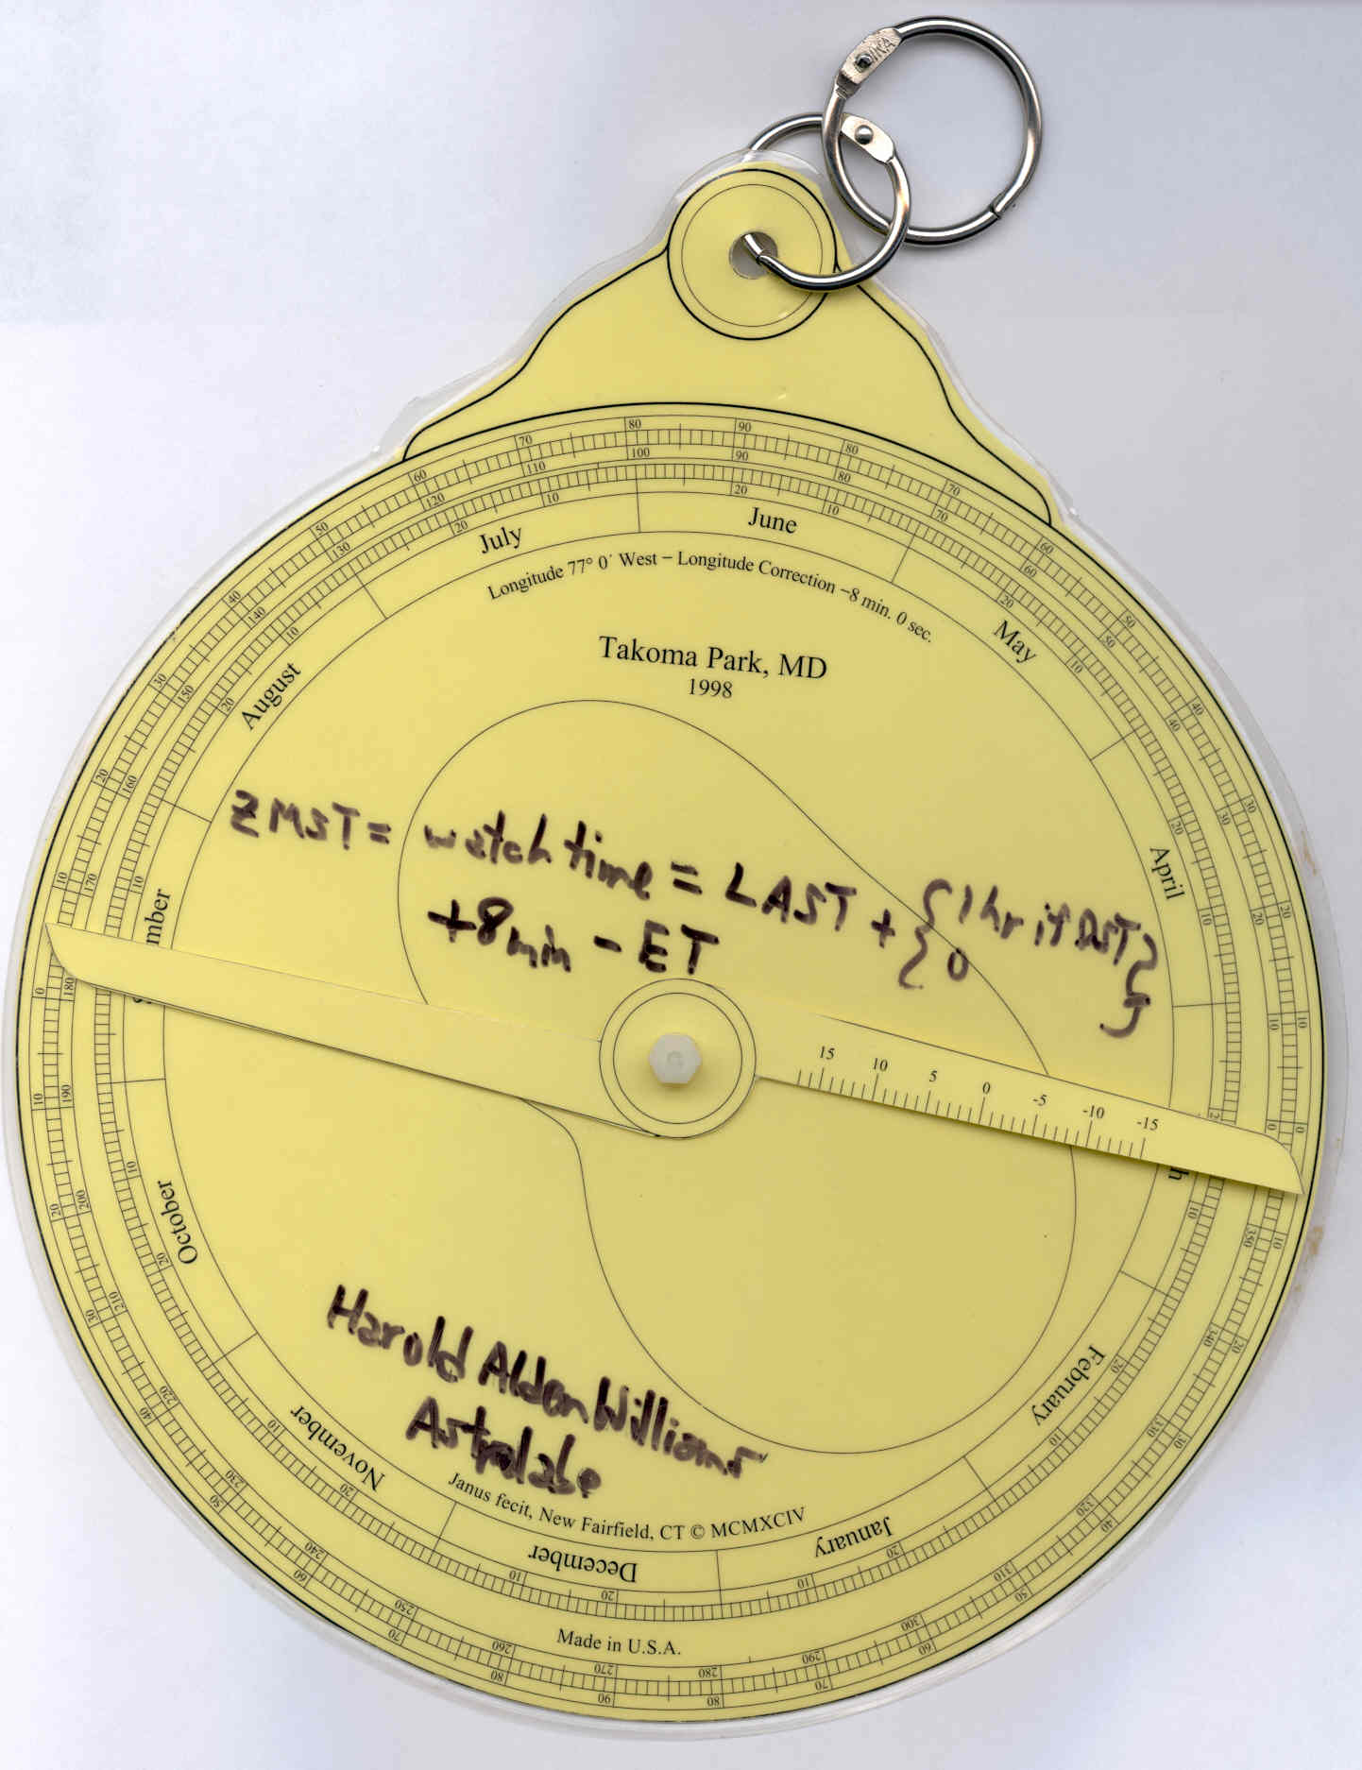
Modern student astrolabe back
Back of Janus Astrolabe with some time equations. For converting to watch time, zone mean solar time, from local apparent solar time with daylight saving correction, and 8 minutes because Takoma Park is not in the center of the time zone, and the equation of time, ET which is the peanut. ET corrects for the obliquity of the ecliptic and the slightly elliptical orbit of the earth around the sun.

Slide 62
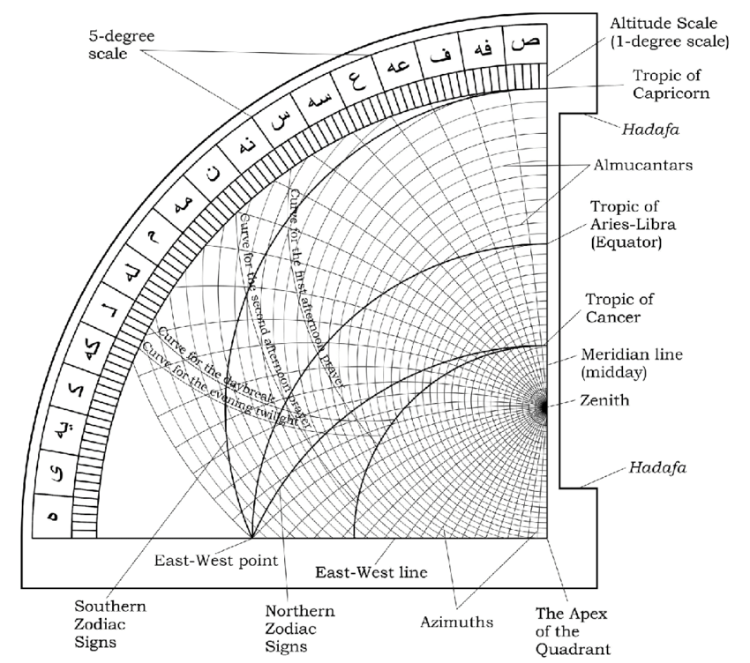
https://en.wikipedia.org/wiki/Canterbury_Astrolabe_Quadrant

Slide 63
Other Astrolabe Resources
The Astrolabe project
http://www.astrolabeproject.com/
https://science8astrolabe.weebly.com/how-to-use.html
http://www.astrolabeproject.com/sim/astrolabe/sim.html
Keith Powell’s Astrolabe home page
http://www.autodidacts.co.uk/astro74xx/newastromain.html

