Slide 1
Removing Barriers to Achieve Diversity Dr. Carol Scarlett Associate Professor, Department of Physics Florida A&M University September 21st, 2020 – APS Webinar – Removing Barriers: Physics in HBCU, MSI and PBI Communities

Slide 2
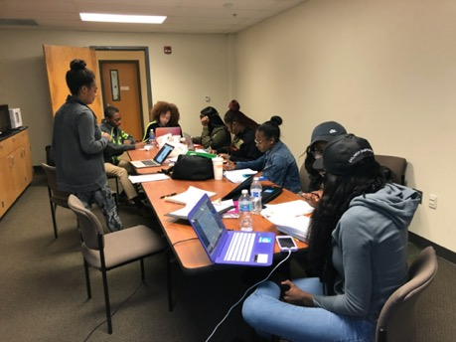
Minority STEM Education Support
Educational Support Models with significant impact on minority student performance
Supplemental Instruction Programs in STEM gateway courses
Informal study sessions lead by a host - Supplemental Instructor
Focuses on student lead review of concepts
Requires buy-in from course faculty
Learning Assistant Programs
Student
Tutoring Sessions

Slide 3
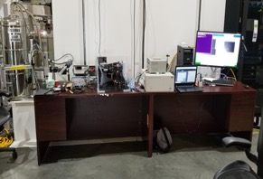
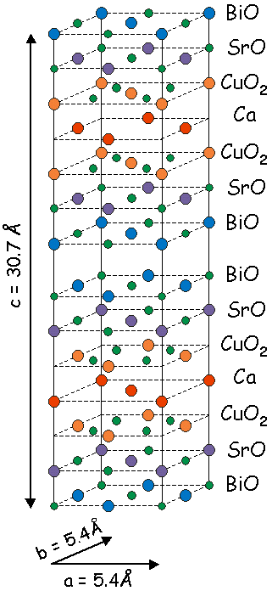
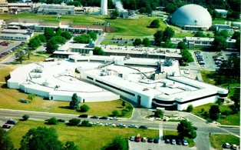
Student Research Programs
Bi₂Sr₂Ca₁Cu₂O_{8+δ}
a.k.a. Bi2212, BSCCO
DOE Offers Summer Undergraduate Laboratory Internships (SULI)
Office of Educational Programs (OEP) at Brookhaven National Lab
NSF Supports Research Experiences for Undergraduates (REUs)
Domestic & International Laboratory programs
University run programs
NNSA Supports Internships at several national laboratories with focus on National Security Issues
NSLS

Slide 4
Faculty Collaboration & Support
National Laboratories across the nation welcome students and faculty
Numerous experiments, particularly in the field of Elementary Particle Physics, rely on faculty at the over 2000 colleges and universities to support and design apparatus enabling research
NSF, NNSA, NRC, DOE and DoEd are all providing grant dollars for programs that have workforce development as a main goal
Workforce Development can be a Means to solving many inclusion and diversity problems
Student preparation allows laboratories to be part of the “village” that supports development of next generation African American scientist

Slide 5
Dedicated Funding Opportunities
Long-term neglect to include Women and African American students has brought us to this point in time
Solutions must connect:
Faculty with resources & collaborators
Students with opportunities:
Academic support to excel in STEM gateway courses
Research faculty to provide indepth exposure to science careers
Pipelines into research programs and labs

