Slide 1
A Student-Centered Approach: We C.A.R.E. To Increase Diversity in Physics
Willie S. Rockward, Ph.D.
Chair and Professor of Physics
Department of Physics and Engineering Physics
Morgan State University
Baltimore, MD
September 21, 2020 – APS Webinar - Removing Barriers: Physics in HBCU, MSI, and PBI Communities

Slide 2
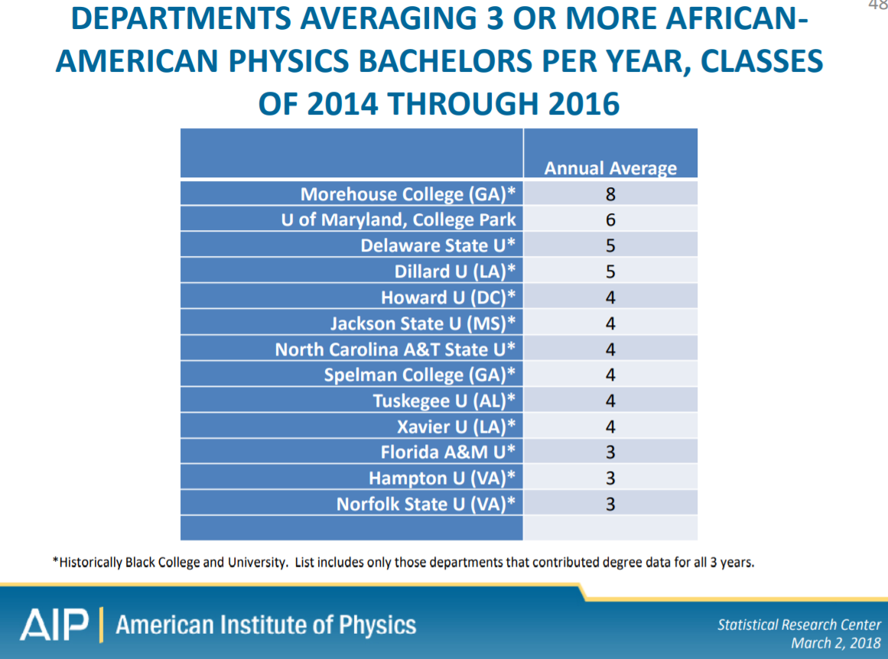
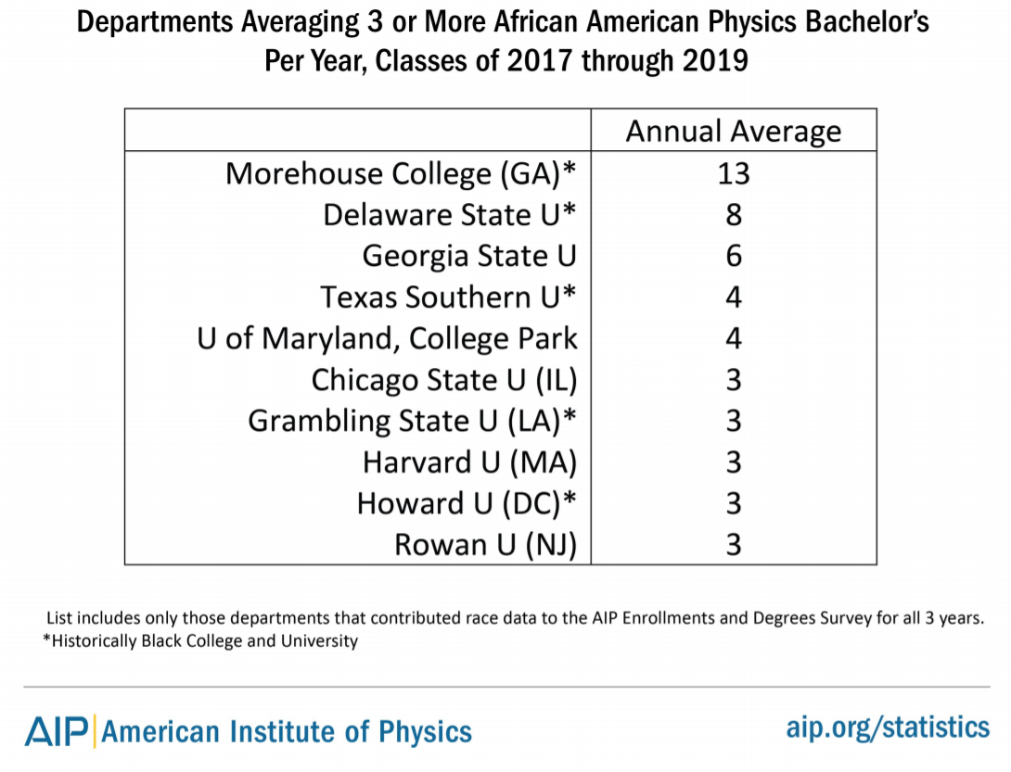

Slide 3
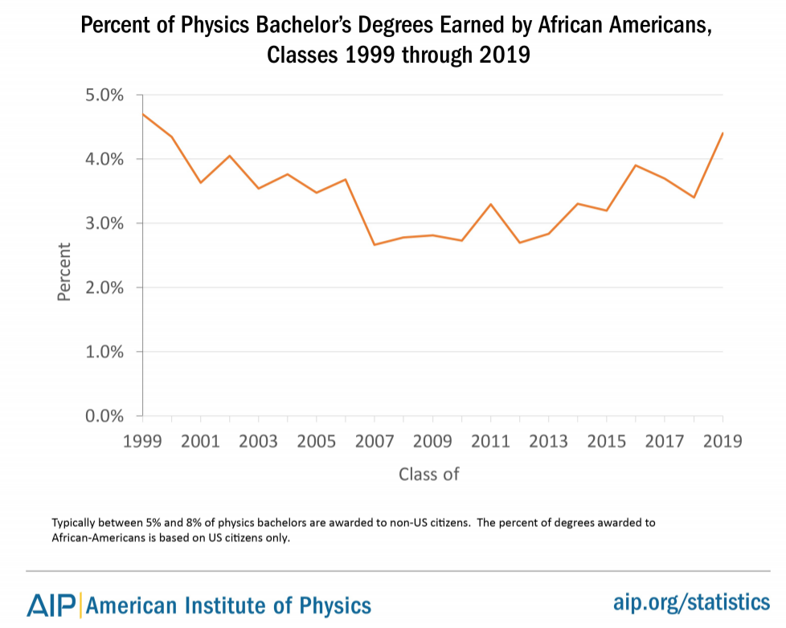

Slide 4
A Student-Centered Approach: We C.A.R.E. Model
Curriculum / Climate
Fixed & Flexible course availability based on student input
Refresh physics major to reflect viable & known career paths
Design department climate to be WELCOMING … CARING … INCLUSIVE …
Expand offerings with pathways – Astronomy, Data Science, HS Teacher, Business/Law/Medical, etc.
Advisement
Career mentoring (academic, life skills, pipelines, SPS career toolbox, etc.)
Recruitment / Retention / Research / Rewards
Pre-collegiate summer programs / Faculty high school visits / Student organizations (SPS, NSBP, etc.)
Saturday Academy / Summer Placements / Honors & Awards / Community-building events
Extras / Excellence / EP3
Graduate School Tours / Diverse Speakers / Dept “The Facts” (i.e., Morgan State birthplace of NSBP)
Town Hall meetings by SPS / Scientific leadership & citizenship / International collaborations
EP3 = Effective Practices for Physics Program

Slide 5
EP3: Partnering with HBCU / BSI Departments to Increase Recruitment & Retention
Alabama A&M
Chicago State
Florida A&M
Morgan State
North Carolina A&T
North Carolina Central
Prairie View A&M
Spelman College
Texas Southern
Xavier University of Louisiana
The EP3 project will solicit interest from all HBCU / BSI departments this fall to determine additional interest.
$100k funding from the National Science Foundation will allow us to visit 8 departments over 2 years. APS hopes to extend this when additional funding can be secured.
This material is based upon work supported by the American Physical Society and the National Science Foundation under Grant Nos. 1738311, 1747563, 1821372, 2033894. Any opinions, findings, and conclusions or recommendations expressed in this material are those of the author(s) and do not necessarily reflect the views of the National Science Foundation.

Slide 6
EP3: Key Aspects of HBCU/BSI/EP3 Partnering Supplement
Goals
Support HBCU/BSI departments in increasing the number of African American students receiving physics bachelor’s degrees
Inform the development of the EP3 Guide from the unique perspective and contexts of HBCU/BSI physics departments
Build connections between physics departments at HBCU/BSIs
Key Elements
Visit 8 HBCU/BSI physics departments over the next 2 years
Visiting teams include HBCU/BSI chair from a different institution, APS Committee on Minorities member, and EP3 leadership member
Conduct site visit focused on recruiting and retaining more physics majors; work with faculty to develop and refine strategic plans aligned with this goal
Stipends for department and visitors
Use and inform the EP3 Guide (currently under development, set for initial release in Dec 2020)
Work with other HBCU/BSIs to make them aware of resources/ideas

Slide 7
THANK YOU!

Slide 8
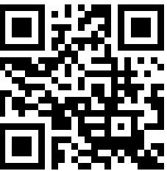
EP3: APS Developing a Toolkit for Departments at Risk
Issue:
Many regional and smaller physics departments are being threatened with closure or significant restructuring
Even large universities are likely to experience significant budget cuts
Response
APS is creating a toolkit with effective practices and case studies to help departments take proactive steps to remain vital in the event of significant budget adjustments
Integrated into EP3 – Effective Practices for Physics Programs
Planned release in Q1 2021

