Slide 1
NMC Recruitment Presentation (Student Groups)
Presenter(s): Undergraduate student group leaders
Audience: Undergraduate physics students, specifically minoritized and marginalized students.
Overview: This 8-slide deck defines the role and benefits of mentoring as well as outlines components and benefits of the APS National Mentoring Community. The intent of this presentation is to expand awareness of the NMC Program in an effort to recruit more undergraduate mentees into the community.
Strategies for use:
Invite a NMC Mentee who is involved in your organization to present about NMC at an organization meeting
Invite a NMC Mentor from your institution to present about NMC at an organization meeting
Invite NMC Staff to facilitate a virtual workshop on mentoring to your organization

Slide 2
Mentoring in Physics
Notes:
Slide 1 - Introduction Slide

Slide 3
The APS National Mentoring Community
The mission of the APS NMC is to address the minoritization and marginalization of people in physics by providing personal and professional development to mentors and mentees, matching mentors and mentees, and providing resources to mentees.
Program Components:
Bringing Emergency Aid to Mentees (BEAM) Fund
NMC Conference
Regular Meetups with other Mentees
Notes:
The APS National Mentoring Community
This slide provides an overview of the National Mentoring Community.
Please emphasize that anyone who identities as marginalized and/or minoritized is welcome to join.

Slide 4
What is a Mentor?
Mentor as defined by Merriam-Webster:
essential meaning: someone who teaches or gives help and advice to a less experienced and often younger person
full definition: a trusted counselor or guide
Mentoring as defined by Eric Parsole:
“Mentoring is to support and encourage people to manage their own learning in order that they may maximise their potential, develop their skills, improve their performance and become the person they want to be.”
Notes:
What is a Mentor?
Before showing definitions, consider asking the audience how they define mentoring
For further discussion: ask the audience what stands out to them most about these definitions

Slide 5
Why is Mentoring Important?
The most important factor in degree attainment was positive mentoring experience (Solorzano, 1993)
The desire to pursue a PhD is influenced by a strong mentee-mentor relationship (McGee and Keller, 2007)
Mentoring increases persistence in science, career satisfaction and productivity (reviewed in Sambunjak, Straus and Marusic, 2010)
Mentoring has been linked to enhanced science identity, sense of belonging and self-efficacy (Palepu et al, 1998; Garman et al, 2001; Paglis et al, 2006; Lopatto, 2007; Bland et al, 2009; Feldman et al, 2010; Cho et al, 2011; Chemers et al, 2011; Thiry and Laursen, 2011)
Notes:
Why is Mentoring Important?
There is no need to go into detail about each bullet point on this slide; the key point is to highlight the positive correlation between mentoring and academic and personal outcomes

Slide 6
Physics Mentors Are Often...
Classmates
More advanced students and graduate students
Postdocs
Staff
Faculty advisors
Research advisors/collaborators
Mentors in other STEM programs like LSAMP, McNair Scholars, and TriO Programs
Many people have more than one mentor!
Notes:
Physics Mentors Are Often…
Feel free to add personal anecdotes to highlight these examples
Be sure to emphasize the importance of having multiple mentors

Slide 7
What Can My NMC Mentor Help Me With?
Navigate Your Academic Journey– Mentors may help with setting academic goals and strategizing how to overcome challenges to reaching your goals.
Career Advice – Mentors can also help you determine your career goals and the best ways to achieve them.
Success Strategies – Mentors can help you understand the best time to apply for scholarships, graduate school, or jobs.
Expand Your Network – Mentors can introduce you to key people to help
you achieve your goals.
Notes:
Note: these are just a few examples. It would also be important to highlight that mentors have often “been there, done that” and can provide support with not only navigating academic and career pathways but also experiences related to having shared identities (race, gender, sexual orientation, nationality, etc…)

Slide 8
Benefits of Joining the NMC as a Mentee
receive career and professional advice from a physicist or faculty member in a related field
receive one-year free student membership in the American Physical Society
get the inside scoop on resources and opportunities like research experiences
access to NMC Bringing Emergence Aid to Mentees (BEAM) grant funds
access to a network of physicists who can help accelerate your education and career
opportunity to apply for funding to attend the National Mentoring Community conference
connect with other physics students from around the country and
around the world
Notes:
Benefits of Joining the NMC as a Mentee
Aside from being connected with a mentor, there are many other benefits to being a NMC mentee, including expanding your network and having access to resources and opportunities for personal and professional growth

Slide 9
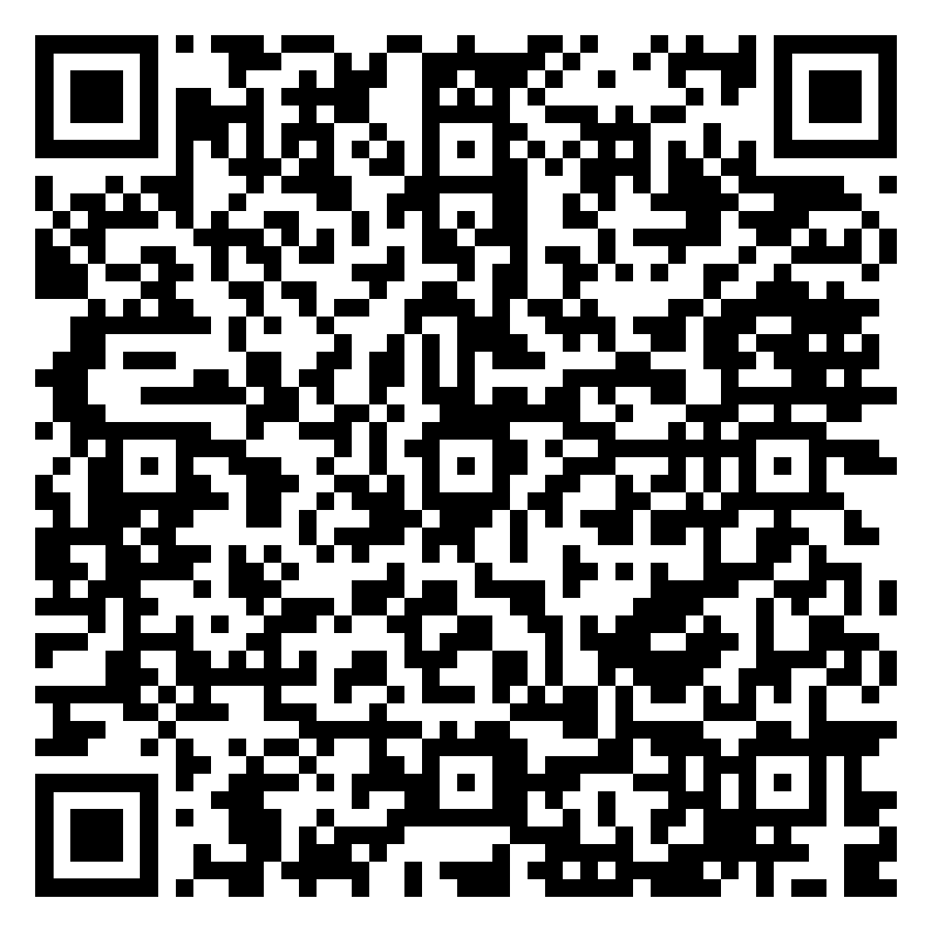
For More Info and to Join the NMC
nmc@aps.org
Learn more about NMC!
Notes:
The QR code directs to the NMC website

