Slide 1
FUNDAMENTALS OF HOLISTIC REVIEW PART III
ALIGNING RECRUITMENT WITH ADMISSIONS
Presenter Name, Affiliation
Presenter Name, Affiliation
Notes:
Online format, 90 minutes

Slide 2
Session Objectives
Identify recruitment practices that serve as common barriers to equity in graduate admissions, and elements of equity-minded recruitment practice.
Understand the role of faculty in broadening applicant pools
Begin to construct a department recruitment plan that is aligned with your admissions rubric
Identify ways that individual faculty can actively participate in the recruitment of students from racially minoritized groups in STEM
Take-home: Develop campus visit programs that yield the students you would like to see enroll in your program
Notes:
Main Point: Our hope today is that you leave with an understanding of how equity-minded recruitment practices will enhance your ability to achieve your admission goals. We will provide time for you to think about tangible steps you can take when your return to your campus/office.

Slide 3
FUNDAMENTAL PRACTICES
FOR ADVANCING RACIAL EQUITY IN GRADUATE EDUCATION
Notes:
Main Point: Advancing racial equity in graduate education will require a comprehensive approach. One that challenges us to think about recruitment, admission, and retention as interlocking rings. In case studies of graduate student enrollment, we find that recruitment practices are a critical component in increasing representation and ultimately the culture of academic departments. Today we will engage in a discussion of graduate student recruitment practices in hopes that we can begin to align our recruitment activities with the goals of our admissions process.

Slide 4
Why Recruitment is Important
Recruitment activities are way to distinguish yourself from peer institutions
Well designed recruitment programs can ensure that “more students see the opportunities to undertake graduate studies” Dr. Sethuraman “Panch” Panchanathan, NSF Director
Social science research has documented the role of recruitment practices in closing the doors of opportunity for individuals from minoritized groups (Posselt, 2016; Rivera, 2015)
How prospective applicants interact with departments and institutions can be a force for advancing equity
Notes:
Main Point: The energy that faculty, departments, and graduate divisions put into recruiting students matters. A coordinated recruitment plan that is focused on equity is an important step in advancing racial equity.
Research in sociology, education, and organizational behavior describe how racial inequality in recruitment and selection processes are often maintained through interactions that individuals have with organizations. In graduate admissions processes there is a tendency to focus on the admissions process as the driver for advancing equity. It is critically important for faculty interested in increasing the compositional diversity of their fields to remember that advancing equity requires a comprehensive approach to the recruitment, selection, and retention of graduate students from marginalized backgrounds.

Slide 5
POLL
WHAT IS YOUR ROLE IN YOUR DEPARTMENT/DIVISION’S
GRAD STUDENT RECRUITMENT PROCESS?
Notes:
Poll or Small group discussion (if in person workshop). Poll everywhere free response

Slide 6
Overview of Research

Slide 7
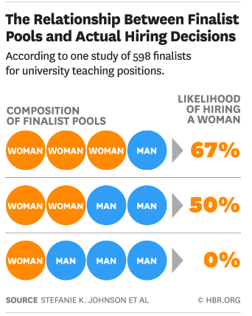
Notes:
Main point: The diversity of the applicant pool you create matters. A diverse applicant pool can enhance your ability to facilitate an equity oriented holistic review process.
What we know about research from hiring and selection about the impact of diverse applicant pools on hiring decisions is that as more candidates from marginalized communities enter the pool, the actual “evaluations of their candidacy” change. A diverse pool challenges status quo perceptions about candidates from marginalized communities (ie. women, Black, Latinx students) and when paired with an equity-minded holistic review process can result in more candidates from underrepresented communities being admitted and enrolling in your program. Today we will spend time thinking about “what happens before” and assist you in performing an equity audit and developing a equity-minded recruitment plan.
https://hbr.org/2016/04/if-theres-only-one-woman-in-your-candidate-pool-theres-statistically-no-chance-shell-be-hired

Slide 8
STAGES OF THE APPLICATION/ENROLLMENT PROCESS
PREDISPOSITION
Is graduate school for me?
SEARCH
Which graduate school is for me?
CHOICE
Which institution should I attend?
(Hossler & Gallagher, 1987; Bersola et al., 2014)
Notes:
Main Point: Scholars have described the doctoral student choice process as a three stage process where students activities are focused on answering three questions.
During the predisposition stage students develop aspirations and decide to pursue a doctoral degree. In this stage programs and faculty can actively diversify the applicant pool through recruitment activities that help students recognize that graduate school is a possibility. In this stage, programs and faculty can develop materials that are targeted for students at HBCU’s and MSI’s (such as open houses, class and lab shadowing, etc.). Faculty and staff at institutions with high concentrations of URM’s can also actively reach out to students that are successful in their courses and have conversations with them about pursuing graduate studies.
In the search phase, students seek out information about specific programs. As noted earlier in this stage students from minoritized communities in higher education will make assessments about campus climate to determine whether a program/department is a good fit for them and their research interests. In this stage students might make outreach to programs and departments and how faculty and program staff respond can make a difference for how students perceive the climate of your program. In this stage prospective students often also attempt to make connections with current students (especially those who share social identities to assess the climate and advising styles of faculty).
In the choice stage students will make their final selection amongst their options. During this stage students will attend campus visits and increase their interactions with faculty to determine if the program is a good fit. As you can imagine during the choice stage students are often making decisions among what might be very similar programs.
Our hope today is that we you might come to think about specific actions you can take at each stage of the

Slide 9
Factors Influencing Doctoral Students’ Choices
Different students are going to be drawn to different facets of a doctoral program. Research has shown that students are drawn to an institution’s curriculum, teaching, academic reputation, and research experiences
Positive interaction with faculty and other members of the doctoral program played a significant role in students’ decisions to enroll in academic programs (Bar et al. 2007; Bersola et al, 2014; Bortz et al, 2019; Poock & Love, 2001)
For students from minoritized backgrounds, campus climate was an important factor that impacted decision making about programs where they would apply/enroll (Bar et al. 2007; Bersola et al, 2014; Posselt, 2020)
For students with families/dependents, campus resources and geographic location were especially important (Bersola et al, 2014; Ramirez, 2013)
Notes:
Main Point: Research studies have demonstrated that there is a disconnect between what students and faculty perceive as the primary factors influencing doctoral student choice. With faculty often determining that financial considerations are most important and that students are primarily making decisions focused on nonfinancial factors. However, in the research that has been done assessing what students considered most important often found that non-financial factors were most often influencing student choice. The most important non-financial factors from individuals who are marginalized in STEM were often climate of the program and interactions had with faculty during the recruitment process.
Many faculty are unaware of the critical role that they play in affecting doctoral student choice processes. Since faculty apprenticeship is the dominant norm in graduate preparation programs the interactions between faculty and students send important signals to prospective students about whether a particular graduate program will be a good fit for them. For students from marginalized groups these interactions take on new meaning because students may be using these interactions to determine whether the program will be safe and affirm their identities and research interests.
Given the critical importance of non-financial factors in the doctoral student choice process it is important for faculty and program administrators to pay attention to whether their practices regarding communication and information sharing may be undermining their goals for advancing racial equity in their doctoral programs.
Incidentally, what we know from studies that are focused on student’s salient identities is that the student choice process is highly individualized. A student’s salient identity (race, gender, marital status, etc) will influence how students will navigate this process. It is critically important as we think about student recruitment practices that we take into account the varying needs that students will be bringing to this

Slide 10
Organizational Climate & Image
Recruitment activities have the potential and power to signal to candidates that your department is a space that will be affirming of their social identities (race, gender, etc.)
In studies in both hiring and admissions candidates from marginalized communities rated organizations that had strong statements that expressed the importance of diversity as more favorable (Purdie-Vaughns et al., 2008; Starck et al., 2021)
Organizational climate is critical in decision-making for individuals from marginalized backgrounds (Avery et al, 2013; Wofford & Blaney, 2021)
Notes:
Main Point: For individuals whose identities have been historically marginalized recruitment activities send important cues about their safety and ability to be successful as potential graduate students.
In the research on organizational attractiveness and doctoral student choice, researchers have found time and time again that candidates from marginalized backgrounds draw cues about whether an organization is a good fit for them through their interaction with recruiters, organization websites, and interactions during interviews and visits. The organizational value for diversity is an important signal of the organization's climate and whether it will be a safe to study grow and learn.

Slide 11
Biases in Recruitment
Faculty Interaction
In an audit study of 6,500 emails from prospective graduate students researchers found that women and students from minoritized backgrounds seeking information from prospective faculty advisors were collectively ignored at 2.2 times the rate of white male applicants (Milkman et al., 2015).
Selective Inclusion
A recent study of 517 student e-mail inquiries to admission decision makers found that emails from Black prospective students who expressed a commitment to antiracism was responded to less frequently than a group of Black students who reveal no interest in racial justice issues (Thornhill, 2019).
Notes:
Main Point: In the literature on admission recruitment we have learned that it is critical for graduate programs to think more broadly about the biases present in their admission processes. While institutions are beginning to address biases and discrimination in the evaluation process, it is important to recognize that a systematic approach is necessary to address biases that may be present in other stages of the admissions cycle.
Routine admission processes such as responses to prospective student email inquiries can serve as a gate-keeping mechanism and possible source of reproducing existing inequalities in graduate education.
The Milkman study included faculty from 89 disciplines and over 250 institutions. This finding raising significant questions given the critical importance of faculty interaction in the doctoral student choice process. Discrmination in the doctoral student pathway to the submission of an application can reduce the number of applicants from marginalized backgrounds who are in your admissions pool.
The Thornhill study raises another set of questions about departmental fit. “Fit” with a department’s culture is often an implicit screening device that also “weeds out”
historically underrepresented students. Program faculty/departments can change their recruitment messages to convey to prospective students that diverse perspectives and
experiences are welcome.

Slide 12
POLL
What has your department done to signal to prospective racially/ethnically minoritized students that your program is a welcoming place to pursue graduate study?
Notes:
Poll or Small group discussion (if in person workshop). Poll everywhere upvote/down vote

Slide 13
QUESTIONS

Slide 14
Equity-minded
Recruitment Practices

Slide 15
ELEMENTS OF EQUITY-MINDED RECRUITMENT PRACTICE
DEMYSTIFY
WELCOME
Implicit norms and expectations for how successful applicants present themselves in the admission process.
Prospective students by creating a climate where they will be cared for and provided the tools to be successful.
REPRESENTING
PARTNERSHIP
DECONSTRUCT
Affirm the belonging of racially/ethnically minoritized groups by representing their experiences & support for their research interest.
Program faculty & staff take responsibility for supporting and establishing relationships with institutions that serve minoritized racial groups.
The information that is presented as the norm for students who successfully apply and enroll.
Adapted from the the Center for Urban Education (Center for Urban Education,. 2017)
Notes:
Main Point: The doctoral student recruitment process can be designed to advance racial equity. Graduate divisions, admission committees, and faculty can embed the following principles in all aspects of their recruitment process to ensure that students from minoritized communities are successful in navigating the graduate school enrollment process.
Demystify: How you clarify the hidden curriculum in the doctoral application process for students? For instance, how is your application designed to ensure students provide the information that is necessary for holistic review.
Welcome: Students from marginalized communities who are navigating the recruitment process are often trying to assess the climate of your program. How are you signaling to prospective students that the climate is one that is welcoming and affirming of their racial or gender identities.
Representing: How are students/faculty from minortized represented in your recruitment materials, campus visit program, or admission process?
Partnership: One of the critical components of equity-mindedness is institutional responsibility, how are you/your department taking responsibility for establishing relationships with institutions or organizations that serve racially minoritized groups (eg, MSI’s, PUI’s).
Deconstruct: Most importantly how you are deconstructing traditional notions of who is a “scientist”? and who is successful in your application process? or your program? For instance when you describe alumni of your program is this a diverse group that is reflective of the cohorts you wish to build? or the future you envision for your discipline?

Slide 16
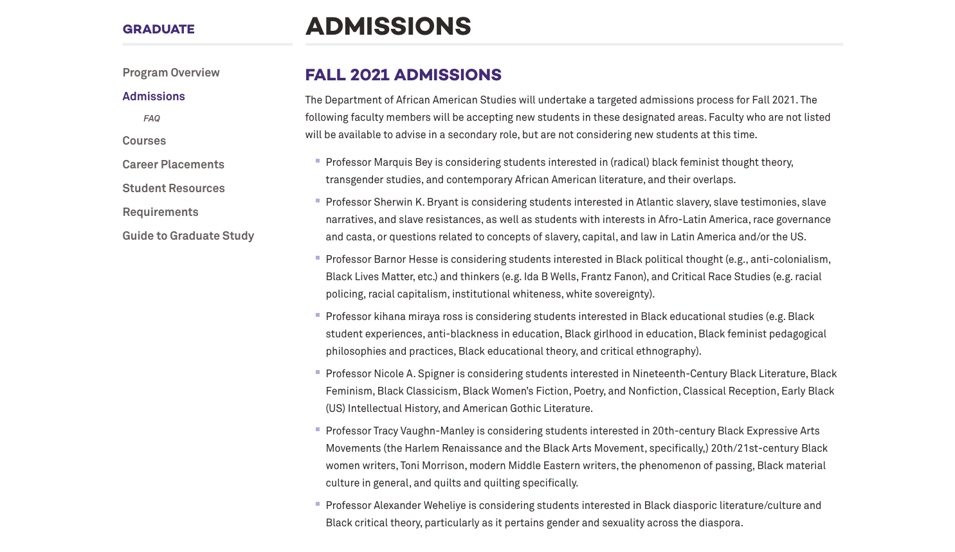
Demystifying the Process (Program)
Notes:
Main Point:
As we seek to develop more equity-minded recruitment processes, we would like to take a moment to highlight some actions that programs can take to ensure that all students have the tools necessary to successfully navigate the application process. The following image highlights how the Department of African American Studies at Northwestern University demystified the application process. The program made information that is typically insider knowledge publicly available via the program website. Given the impact of differential access to information in the perpetuation of inequality in selection processes making information transparent and accessible to prospective applicants is critically important for advancing equity.

Slide 17
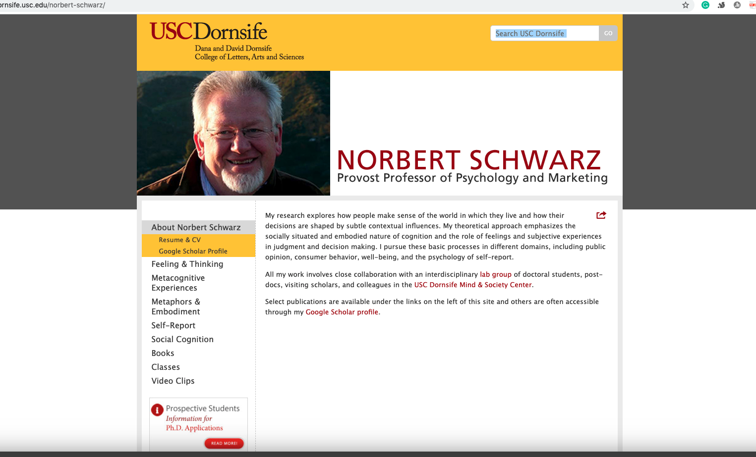
Demystifying the Process (faculty)
Notes:
Main Point: This image highlights what faculty members can do outside of program pages to ensure a more equitable admissions process. As you can here Dr. Schwarz has information for prospective students featured prominently on his faculty page on the university website. The prospective student page provides information about the research conducted by graduate students in his laboratory, how prospective applicants can communicate with Dr. Schwarz, and information about students that have been successful in the enrolling in his program.

Slide 18
Welcoming & Representing Department and Program Climate
A Student Example from the research
“Diversity was a huge part of the application process from what I remember. I think they were starting the [curricular initiative] at the time. I feel one of the things we had to address in our essays . . . was diversity. There was a website . . .devoted to diversity . . . so it seemed, like I said, on paper to be something that was really important to the school.” (African American Doctoral Student)
(Slay, Reyes, & Posselt, 2019)
Notes:
Main Point: Application prompts, institutional websites, are all examples of ways that programs sent signals to prospective students that their campus was welcoming for students from minoritized student groups.
The following excerpt was taken from Slay et al, 2019 and illustrates the importance of designing a recruitment process that is welcoming and representative of the diverse interests of prospective applicants. Here a doctoral student is sharing information about how they learned about the climate in their department. As you can see the prospective student, gleaned information about the climate from the application prompts and a designated diversity website.
From the empirical research on student choice, faculty hiring, and organizational behavior one thing is pretty consistent. How we frame opportunities will influence whether applicants from minoritized backgrounds will submit applications.
In a recent empirical study (Starck, Sinclair, & Shelton, 2021) that studied the content of university diversity statements, researchers found that Black applicants had preferences for universities who statements made strong commitments to racial justice. This study is aligned with previous research that students from minoritized backgrounds look to university webpages/interactions during the recruitment process to determine whether a department/institution is welcoming. This signals that it is critically important to review your department/graduate division websites with attention to how you communicate that students from minortized communities will be welcomed and supported in your community.

Slide 19
Activity# 1
WEBSITE SCAN

Slide 20
Activity # 1 - Website Scan
Step 1: Select a graduate program website to review
Step 2: Identify excerpts on the program website that identify what prospective applicants must do to be successful in your admission process
Step 3: Look for excerpts you have selected and using the following categories indicate how the website Demystifies, Welcomes, or Represents
Step 4: Share your findings with a partner
Notes:
The Website Scan is designed to provide you an opportunity to explore the ways prospective students, and particularly students from minortized racial/ethnic backgrounds, may view the language and admissions processes outlined by your academic program.
Our hope is that you will walk away from this exercise with an opportunity to practice reading your program/division website from a student’s perspective and also that you have the opportunity to identify ways that you may wish to revise content on your website from an equity minded perspective.

Slide 21
FUNDAMENTAL PRACTICES
FOR ADVANCING RACIAL EQUITY IN GRADUATE EDUCATION
Notes:
Main Point: Bait & Switch

Slide 22
CHALLENGES & OPPORTUNITIES
DENIAL of RESPONSIBILITY for OUTREACH
CHALLENGE: Passive outreach strategies often remove the responsibility for generating diverse applicant pools from departments/faculty (Griffin & Muniz, 2015; Liera, 2020b; O’Meara et al., 2020)
OPPORTUNITY: Faculty involvement can have significant impact on the strength and quality of the applicant pool.
Notes:
Main Point: A comprehensive recruitment plan that involves faculty and the graduate school can make all the difference in determining whether your program has an applicant pool or puddle.
Case studies of graduate programs and faculty hiring processes have demonstrated the impact that a group of faculty can have in shaping a diverse applicant pool. Since the role of faculty in this process is not clearly defined there is a lot of opportunity for programs to think creatively about how they might expand their applicant pool.

Slide 23
CHALLENGES & OPPORTUNITIES
INEQUITABLE ACCESS TO INFORMATION
CHALLENGE: Students from marginalized groups often have differential access to critical information networks (Kachchaf et al., 2015)
OPPORTUNITY: Through strategic partnerships and intentional actions faculty and program staff can work to demystify the application process for students who are from minoritized communities.
Notes:
Main Point: Closed information networks are often a key factor in social closure.
Closed information networks can add to the cumulative disadvantages experienced by students from minoritized groups. Burris in a study of prestige hierarchies in Sociology found that graduates of the top 20 departments took 70% of the total faculty positions in 94 departments. As one can imagine prestige hierarchies find their way into graduate admission processes as well. In order to prevent prestige hierarchies we must broaden information networks so that students from institutions that serve large concentrations of Black, Latinx, Pacific Islander, of Indigenous students. Through strategic partnerships we can insure that access to the information that is critical to success is not only available to students who come from highly selective colleges and universities.

Slide 24
CHALLENGES & OPPORTUNITIES
PROBLEM of the LEAKY PIPELINE METAPHOR
CHALLENGE: In higher education faculty and administrators often point to leaky pipelines (Griffin, 2020; Smith et al., 1996; Turner et al., 1999) and small pools of qualified people of color (Ross & Gatta, 2009) as a significant challenge to advancing racial equity.
OPPORTUNITY: In many disciplines there is a gap between the percentage of students from minoritized groups enrolled in graduate school and those who have graduated with bachelors degrees.
Notes:
Main Point: The leaky pipeline metaphor can often lead us to believe that achieving racial equity is insurmountable. The challenge with the leaky pipeline metaphor is that pipelines are rigid and assume that there is a linear path to completion. If we think about pathways rather than pipelines we begin to realize that if we expand our ideas of where high quality students come from and broaden our ideas of the experiences that they have had, we will quickly come to realize that we can generate applicant pools that help us craft the cohorts we want.

Slide 25
QUESTIONS

Slide 26
Developing a Recruitment Plan

Slide 27
Activity# 2
RECRUITMENT PLAN

Slide 28
PREDISPOSITION
Recruitment Planning
Faculty/department outreach to students (internal)
research opportunities
considering graduate studies
SEARCH
Update department website
Revise departmental recruitment webinar
Host webinar in conjunction with MSI/HBCU
CHOICE
Revise campus visit schedules
Conduct a data dive in conjunction with institutional research
Notes:
Main Point: The following list are sample activities that you may wish to consider when developing your recruitment plan. As you develop your recruitment plan we encourage you to approach this task with prospective students in mind. Given what is known about what is important for students during the predisposition, search, and choice stages what steps might you take to advance racial equity while using the elements of equity-minded recruitment practice that were introduced to you during this session.
As you develop your recruitment plan we wanted to take a moment and share some ideas with you about simple steps you can take to create a more equity-minded recruitment process that is aligned with your departmental goals to advance racial equity. In developing your ideas you may want to consider how you might approach recruitment from a systems point of view. Some questions you might wish to consider. How might you collaborate with your colleagues in the graduate division or your geographic area? How can you develop the interest of undergraduate students in your courses who might not have considered graduate study?

Slide 29
Activity# 3
CAMPUS VISIT

Slide 30
The Campus Visit
Department and Program Climate
A Student Example from the research
“I visited some programs while I was an undergrad and applying. That was somewhat discouraging because I would go to these schools… One visit I made to [was] at [a prestigious graduate school]. I had gotten this fellowship that paid for me to visit these places. And they basically didn’t give me any attention. They Just said, “Hi, here’s the department. You know your way around.” It was very discouraging because I had applied there.” (Latina Doctoral Student)
(Ramirez, 2013)
Notes:
Main Point: Negative student experiences during the campus visit experience can alter student perspectives of the climate of your program and discipline.
The following excerpt was taken from Ramirez study on the graduate school choice process for Latinx students. This student would go on to share that she felt that her experience spoke to climate of the department and discipline more broadly. She ultimately decided to pursue graduate studies at a different university in a different discipline. As we design campus visit experiences, we must remember that our actions send strong signals to prospective students especially those who are from marginalized communities. Our behaviors can affirm existing perceptions of our disciplines and our openness to students from minoritized backgrounds.

Slide 31
The Campus Visit
Department and Program Climate
A Faculty Example from the research
A staff member acknowledged that for both the graduate student and the faculty community, “recruitment is extremely important to the continuation of this department” (Chemistry Department, High Tower University)
(Posselt, 2020, p. 70)
Notes:
Main Point: We can take what we learn from successful faculty hiring practices into the recruitment process for graduate students.
In Julie’s book Equity in Science Julie shares a story about a chemistry department that attracted a critical mass of women. When asked to describe what they did to recruit women graduate students many of the faculty in the Chemistry department at High Tower University discussed what they described as a carefully designed campus visit weekend. In this case faculty saw the impact of visit days on their faculty recruitment efforts and focused on revising their prospective student visit to account for what they learned.

Slide 32
QUESTIONS

Slide 33
Twitter
Stay connected with us!
Website
Email

Slide 35
additional slides

Slide 36
Activity# 4
DATA TOOLS/STRATEGIES

Slide 37
Strategy 1: Diagnosing Inequities
Data Strategies & Tools for Racial Equity
Identify racial equity gaps in your applicant pool. This will provide insight into actions you can take to advance equity.
Strategy 2: Data Close to Practice
Work with IR, the grad division, or program admin to gather unit/program level application data.
Strategy 3: Equity-minded Data Analysis
Analyze data from an equity minded perspective by asking questions about what is not working for minoritized groups.
Strategy 4: Eliminating Equity Gaps
Once gaps are identified attempt to link them to policies/ practices that might be barriers to advancing equity
Strategy 5: Setting Equity Goals
Develop short, medium, and long term goals that will help keep you on track with your racial equity goals.
Adapted from the the Center for Urban Education (Center for Urban Education, 2017)

Slide 38
Inclusive Recruitment Practices in
High Diversity STEM PHD Programs
Ensure online presence communicates commitment to diversity equity, inclusion
Engage with MSIs & HBCU’s
Coordinate with graduate school outreach and recruitment
Ensure timely responses to email inquiries from prospective students
Pay attention to cues sent at campus-visit weekend
Recruit undergraduates directly from their institution as appropriate
Bridge Program
Diversity Fellowships
Create a climate in which current students gladly serve as ambassadors
(Posselt, 2020, p. 147)
Notes:
Main Point:
As we close, I want to take a moment and summarize the inclusive practices that we have discussed and you have offered as examples of inclusive recruitment practices in the past 90 minutes. From the research on departments that have been successful in advancing racial equity, we know that redesigning our everyday practices can go a long way in sending signals that departments, programs, and graduate divisions are committed to the success of individuals who are from marginalized groups. As you continue to engage in conversations after you leave here today we would love to hear about your experiences so that we can share insights with departments and divisions engaged in similar change efforts.

