Slide 1
PIE Physics Innovation & Entrepreneurship

Slide 2
Science and Business … How do we describe science and business? (What do you think of? What do they do?)
What are differences?
What are the similarities?

Slide 3
Ref: Google Search Images “Scientific Method”

Slide 4
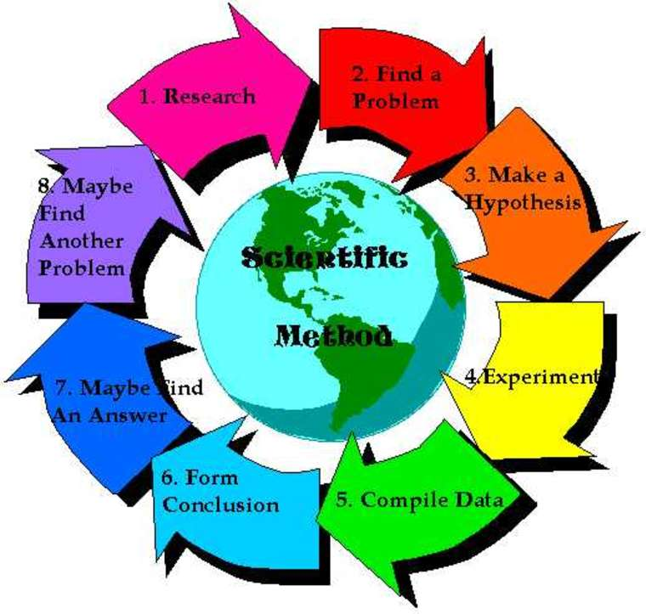
ASSUMPTIONS
World Views
Motivation of why
http://file2.answcdn.com/answ-cld/image/upload/w_760,c_fill,g_faces:center,fl_lossy,q_60/v1/tk/view/answ-images/1c12a7f1/aec0713431adaa8305fd8b2f4615ba2bca9afc51.jpg
Notes:
The one that resonated with me. One of the points is every scientist would likely pick a different model. What is similar!?!?

Slide 5
https://commons.wikimedia.org/wiki/File:Scientific_Method_3.jpg

Slide 6
Why do we do either one? What do they create for society?

Slide 7
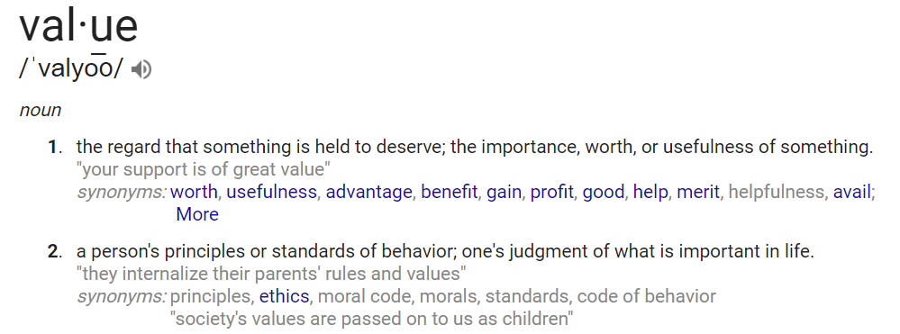
Why do we do either one? What do they create for society?
Ref: Google Search
Notes:
Point – anything we do, whe

Slide 8
Notes:
Point to make is to parallel the PROCESS of how “science” and “business/industry” move forward. There are significant parallel and each creates “VALUE” to society. Everything that we engage in should create value for someone (intellectual knowledge for society, to the next greatest cell phone to look up that knowledge for the ‘consumer’).

Slide 9
NABC – Value Proposition and an Elevator Pitch – An important problem or need is addressed through a unique approach that has benefits when compared to competition.
A
B
C
N
Identifying a problem/need
Asking the right questions!
Be quantitative.
(scientific question/problem and formulate a hypothesis)
How we do solve the problem? Determine an approach to take. (Design the experiment, select technologies)
Client and/or
Market
What is the Competition or alternatives to meeting this need? Compare the benefits and costs and value to the client. (How do others approach this and does this approach have better benefits)
Quantitative benefits – specifically, how does the client benefit (better, faster, cheaper, …). Benefit/cost ratio. (sensitivity, time, uncertainty, resolution, cost, infrastructure, personnel … how is the data better)

Slide 10
Need (note: faculty can use their research as an example)
Remotely monitor physiological signs (heartbeat, respiration, temperatures…) for remote triage
Discuss research …

