Slide 1
Physics Innovation and Entrepreneurship
Mechanical Energy Module
“This module was developed at Loyola University Maryland, based on support by NSF IUSE program under NSF award number 1625089.”

Slide 2
Work, Energy and Power
Problem: Approximately, what is your change in gravitational potential energy when you climb a set of stairs?
ΔU_{g} = m g Δy
What is your mass?
m ~ 75 kg
What is the height of a flight of stairs?
Look it up!
Δy ~ 4 m
ΔU_{g} ~ (75 kg)(10 N/kg)(4 m) = 3000 J

Slide 3
Work, Energy and Power
Problem: Approximately, how much work do you do when you climb a set of stairs?
W = ΔU_{g} ~ 3000 J
Note that you do this work on yourself.

Slide 4
Work, Energy and Power
Problem: Approximately, what is your power output as you (leisurely) climb a set of stairs?
P = W/Δt
How long does it take to leisurely climb a set of steps?
Δt ~ 15 s.
P ~ (3000 J)/(15 s) = 200 W

Slide 5
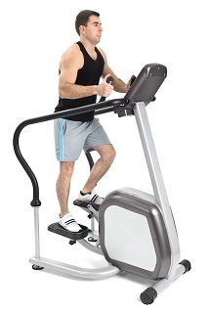
Work, Energy and Power
Problem: Suppose you “climb” the same distance on a stair-climbing machine. Is the work you do the same?
Seems like it must be.
Where does the energy go?
Energy is “lost” to thermal energy (the room warms up).
Can you think of any ways you could use what we have just learned?
Power output ~ 200 Watts

Slide 6
Useful Applications of Human-generated Mechanical Power
Power electrical devices
Wait until next semester – electrical energy and power
One example: The Monstrosity Bike
Any other needs that could be addressed?
.
.
.

Slide 7
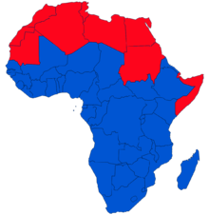
Useful Applications of Human-generated Mechanical Power
Sub-Saharan Africa
Where is the economy focused?
80% Sub-Saharan Africans are farmers
Tanzania – half GDP from farming and 80% of employment from farming
Uganda 85% of economic output based on farming
Irrigated agriculture has greatest potential impact

Slide 8
Useful Applications of Human-generated Mechanical Power
Could we develop a human-powered pump for irrigation in sub-Saharan Africa?
The thousand dollar question:
Would you invest $1000 in my company?
Initially, this is a feasibility question.

Slide 9
Feasibility of a Human-powered Irrigation Pump
What do we need to know/assume/estimate?
How much land (acres)?
How much water per acre?
How high must we lift the water?
How long can a person operate a pump?
How do we determine these things?
Make assumptions and/or use Google!

Slide 10
Feasibility of a Human-powered Irrigation Pump
How much land?
1 acre
How much water per acre?
One approximation: 20,000 liters
How high must we lift the water?
10 m seems reasonable (from a well?)
How long can a person operate a pump?
Two hours?

Slide 11
Feasibility of a Human-powered Irrigation Pump
Let’s ask: How long does it take to pump enough water to irrigate one acre?
1 acre
How much water per acre?
One approximation: 20,000 liters
How high must we lift the water?
10 m seems reasonable (from a well?)

Slide 12
Feasibility of a Human-powered Irrigation Pump
One liter of water has a mass of 1 kg, so the work required to raise 20,000 liters 10 meters is
W = mgh = (20,000kg)(10N/kg)(10m)
= 2 x 10⁶ J
If we do 200 J or work every second, the required time is
t = (2 x 10⁶ J)/(200 J/s) = 10⁴ s = 2.8 hours
So this seems feasible.
Would you invest $1000?

Slide 13
Practicality of a Human-powered Irrigation Pump
Other mechanical issues:
Pump design
Friction (efficiency)
Materials
Locally available?
Repairs/spare parts
Cost
Can farmers afford it?
Can some profit be made?

Slide 14
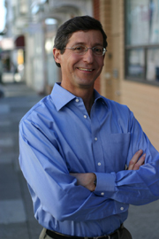
Martin Fisher and Kickstart
“Poverty to Prosperity in Just One Season”
http://kickstart.org/
https://www.youtube.com/watch?v=PCPRgOGFElY
Notes:
Social Entrepreneur Martin Fisher and how he is using entrepreneurship throughout his company of Kickstart, formerly known as ApproTEC.

Slide 15
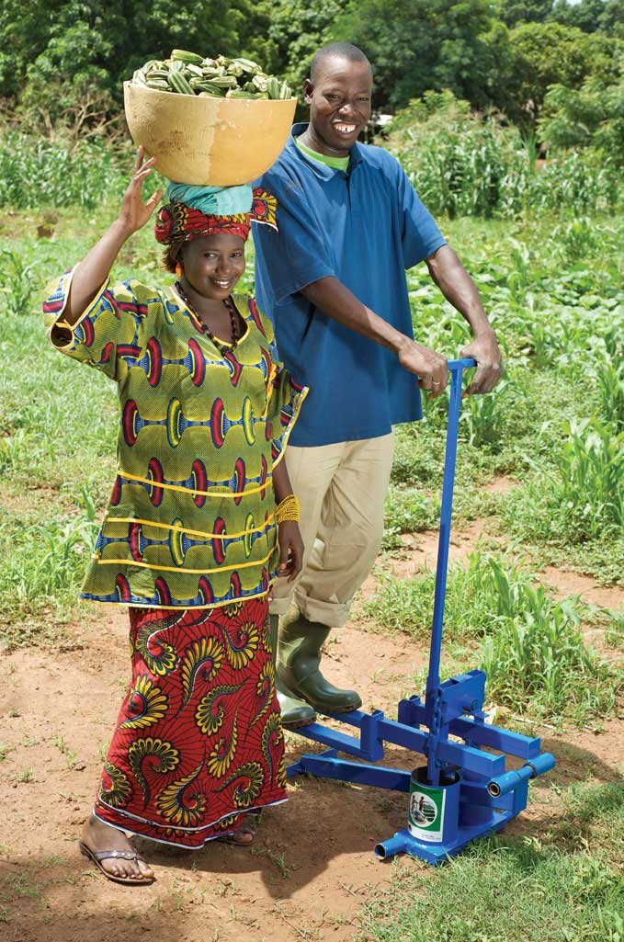
Kickstart’s Technology History: Super MoneyMaker (1998)
Dual piston micro-Irrigation pump
Can pump from 7m
below to 7m above
(or 200m horizontally)
Weighs 45 pounds
Waters 2 acres
Efforts similar to walking
Costs about $95
Notes:
Their next technology was the great success of the Super-MoneyMaker Pump in 1998.
This a small scale irrigation pump that uses human power to pump water from as deep as 23ft
The pump weights 45 pounds, can water 2 acres in a 6 hour days
Pump rate is about 1 liter/second

Slide 17
Kickstart and Martin Fisher Awards and Honors
Martin Fisher
Design News Magazine’s Engineer of the Year, 2008
$100,000 Lemelson MIT Award for Sustainability, 2008
OneWorld.net Person of the Year Award, 2008
Kickstart International
Drucker Award for Nonprofit Innovation, 2008

Slide 18
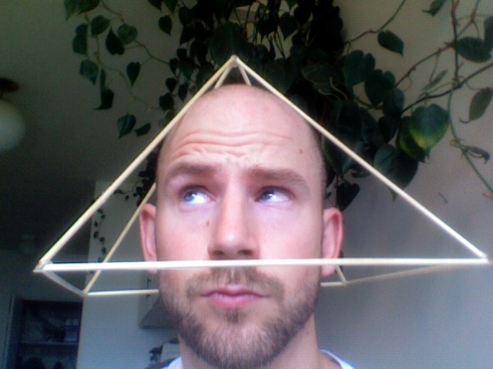
Other interesting (?) ideas Would you invest your money?
Pyramid Power

Slide 19
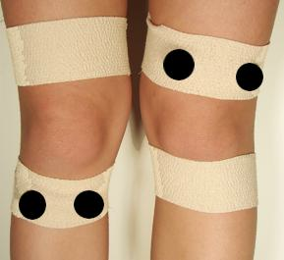
Other interesting (?) ideas Would you invest your money?
Magnet Therapy

Slide 20
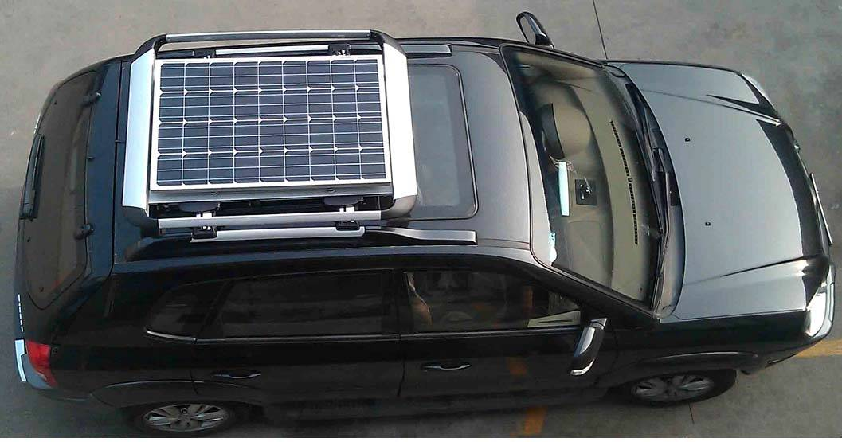
Other interesting (?) ideas Would you invest your money?
Solar Panel on a car roof

Slide 21
PH491/CS491/EG491 Technical Innovation and Entrepreneurship
Learn how to start with an idea and take it through to a finished, marketable product
Idea generation / Feasibility
Intellectual property
Business plan
Financing
Marketing
patents

