Slide 1
W22: Teaching Innovation and Entrepreneurship in Physics AAPT Summer Meeting – W22a, Sunday, July 21, 2019
Randall Jones, Bahram Roughani
Physics Department, Loyola University Maryland

Slide 2
First-year Physics
Human Desirability
Financial viability
Innovation and Entrepreneurship
Technical Viability

Slide 3
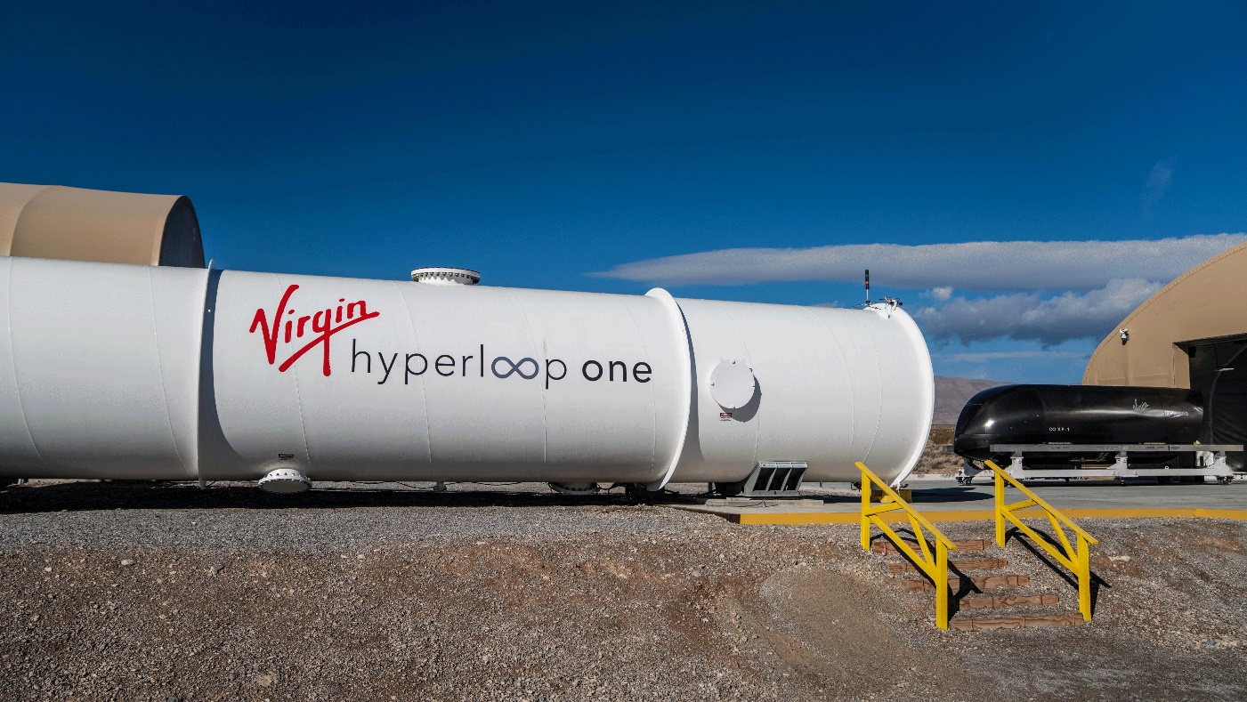
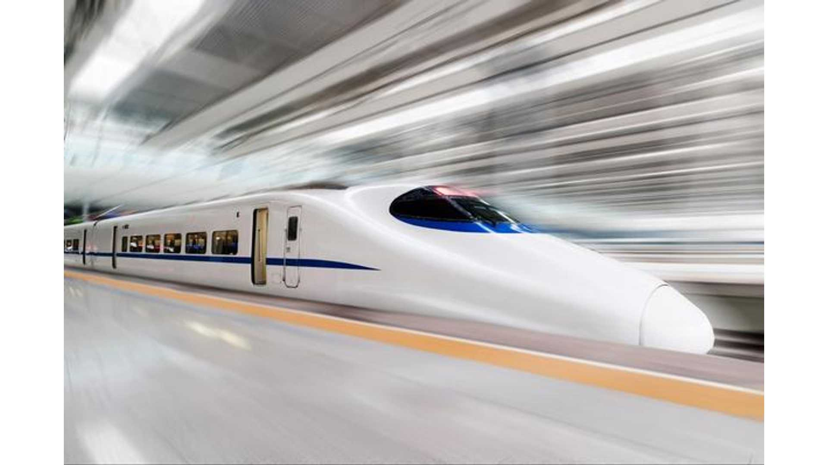
The Hyperloop
The Hyperloop is a futuristic transportation system consisting of pods that would be able to travel at 760 miles per hour by magnetic levitation on tracks through a tube in which the air has been evacuated.

Slide 4
Week 1: Constant Acceleration
The Hyperloop (Link2) is a futuristic transportation system consisting of pods that would be able to travel at 760 miles per hour by magnetic levitation on tracks through a tube in which the air has been evacuated.
How long would it take to travel from Boston to Washington DC at that speed? (The distance from Boston to Washington is approximately 630 km)

Slide 5
Week 1: Constant Acceleration
The Hyperloop is a futuristic transportation system consisting of pods that would be able to travel at 760 miles per hour by magnetic levitation on tracks through a tube in which the air has been evacuated.
How long would it take to travel from Boston to Washington DC at that speed? (The distance from Boston to Washington is approximately 630 km)
$$x=v∗t$$
$$x=630 \text{km}=630,000 \text{m}$$
$$v=760\frac{\text{miles}}{\text{hour}}∗\frac{\text{1609.34 }\text{m}}{\text{mile}}∗\frac{\text{hr}}{\text{3600 }\text{s}}=340 \text{m}\text{/}\text{s}$$
The total time it would take to travel from Boston to DC would be
$$t=\frac{x}{v}=\frac{\text{630,000 }\text{m}}{\text{340}\frac{\text{m}}{\text{s}}}=1850 \text{s}∗ \frac{\text{min}}{\text{60 }\text{s}}=30.9 minutes$$

Slide 6
Week 1: Constant Acceleration
The Hyperloop is a futuristic transportation system consisting of pods that would be able to travel at 760 miles per hour by magnetic levitation on tracks through a tube in which the air has been evacuated.
How long would it take to travel from Boston to Washington DC at that speed? (The distance from Boston to New York is approximately 630 km)
30.9 minutes
The pod must, of course, start from rest and accelerate up to its maximum speed and then decelerate to rest at the end of the trip. Assuming a “comfortable” acceleration, how much time would this add to the trip?
Human Desirability Question:
What is a “comfortable” acceleration?
Web search; Calculation, Jet plane takeoff…
$$a≈1.5 {\text{m}\text{/}\text{s}}^{2}$$

Slide 7
Week 1: Constant Acceleration
The pod must, of course, start from rest and accelerate up to its maximum speed and then decelerate to rest at the end of the trip. Assuming a “comfortable” acceleration of 1.5 m/s² (approximately the acceleration of a jet plane on the runway), how much time would this add to the trip?
The time it takes for the train to accelerate to a velocity of 340 m/s and the distance it travels during this time can be determined using the constant acceleration equations:
$v=v_{0}+at$ $x=v_{0}t+\frac{1}{2}at^{2}$
The initial numerical values are $v=340 ; v_{0}=0; a=1.5\frac{m}{s}$
The time is thus
$$t=\frac{v}{a}=\frac{340 \text{m}\text{/}\text{s}}{1.5 \text{m}\text{/}{\text{s}}^{\text{2}}}=227 \text{s}∗\frac{1\text{min}}{60 \text{s}}=3.78 \text{min}$$
The distance travelled while the train is accelerating is determined using
$$x=\frac{1}{2}at^{2}=\frac{1}{2}\left(1.5 \text{m}\text{/}{\text{s}}^{\text{2}}\right){\left(227 \text{s}\right)}^{2}=38,600 \text{m}=38.6 \text{km}$$
The distance and time required to stop are the same as the distance and time required to start, so the distance that the train operates at a constant velocity of 340 m/s is
$$630,000 \text{m}−2(38,600 \text{m})=553,000 \text{m}$$
and the amount of time it takes to travel this distance at 340 m/s is
$$t=\frac{x}{v}=\frac{553,000 \text{m}}{340 \text{m}\text{/}\text{s}}=1630 \text{s}=27.2 \text{min}$$
The total duration of travel is $(27.2 \text{min}\text{)}+2\left(3.78 \text{min}\right)= 34.8 \text{min}$
Which means 3.9 minutes is added to the travel time due to acceleration and deceleration.

Slide 8
Week 1: Constant Acceleration
The Hyperloop is a futuristic transportation system consisting of pods that would be able to travel at 760 miles per hour by magnetic levitation on tracks through a tube in which the air has been evacuated.
How long would it take to travel from Boston to Washington DC at that speed? (The distance from Boston to New York is approximately 630 km)
30.9 minutes
The pod must, of course, start from rest and accelerate up to its maximum speed and then decelerate to rest at the end of the trip. Assuming a “comfortable” acceleration of 1.5 m/s² (approximately the acceleration of a jet plane on the runway), how much time would this add to the trip?
3.9 minutes is added to the travel time due to acceleration and deceleration.

Slide 9
Week 1: Constant Acceleration
The pod must, of course, start from rest and accelerate up to its maximum speed and then decelerate to rest at the end of the trip. Assuming a “comfortable” acceleration of 1.5 m/s² (approximately the acceleration of a jet plane on the runway), how much time would this add to the trip?
Graphical Solution

Slide 10
Week 1: Constant Acceleration
The pod must, of course, start from rest and accelerate up to its maximum speed and then decelerate to rest at the end of the trip. Assuming a “comfortable” acceleration of 1.5 m/s² (approximately the acceleration of a jet plane on the runway), how much time would this add to the trip?
Graphical Solution
v
t

Slide 11
Week 1: Constant Acceleration
The pod must, of course, start from rest and accelerate up to its maximum speed and then decelerate to rest at the end of the trip. Assuming a “comfortable” acceleration of 1.5 m/s² (approximately the acceleration of a jet plane on the runway), how much time would this add to the trip?
Graphical Solution
v
t

Slide 12
Week 1: Constant Acceleration
The pod must, of course, start from rest and accelerate up to its maximum speed and then decelerate to rest at the end of the trip. Assuming a “comfortable” acceleration of 1.5 m/s² (approximately the acceleration of a jet plane on the runway), how much time would this add to the trip?
Graphical Solution
v
t

Slide 13
Week 1: Constant Acceleration
The pod must, of course, start from rest and accelerate up to its maximum speed and then decelerate to rest at the end of the trip. Assuming a “comfortable” acceleration of 1.5 m/s² (approximately the acceleration of a jet plane on the runway), how much time would this add to the trip?
Graphical Solution
v
t

Slide 14
Week 1: Constant Acceleration
The pod must, of course, start from rest and accelerate up to its maximum speed and then decelerate to rest at the end of the trip. Assuming a “comfortable” acceleration of 1.5 m/s² (approximately the acceleration of a jet plane on the runway), how much time would this add to the trip?
Graphical Solution
v
$$t_{1}$$
$$t_{1}$$
t
Additional time: $t_{1}=v_{\text{max}}/$a

Slide 15
Week 1: Constant Acceleration
The pod must, of course, start from rest and accelerate up to its maximum speed and then decelerate to rest at the end of the trip. Assuming a “comfortable” acceleration of 1.5 m/s² (approximately the acceleration of a jet plane on the runway), how much time would this add to the trip?
The time it takes for the train to accelerate to a velocity of 340 m/s and the distance it travels during this time can be determined using the constant acceleration equations:
$v=v_{0}+at$ $x=v_{0}t+\frac{1}{2}at^{2}$
The initial numerical values are $v=340 ; v_{0}=0; a=1.5\frac{m}{s}$
The time is thus
$$t=\frac{v}{a}=\frac{340 \text{m}\text{/}\text{s}}{1.5 \text{m}\text{/}{\text{s}}^{\text{2}}}=227 \text{s}∗\frac{1\text{min}}{60 \text{s}}=3.78 \text{min}$$
The distance travelled while the train is accelerating is determined using
$$x=\frac{1}{2}at^{2}=\frac{1}{2}\left(1.5 \text{m}\text{/}{\text{s}}^{\text{2}}\right){\left(227 \text{s}\right)}^{2}=38,600 \text{m}=38.6 \text{km}$$
The distance and time required to stop are the same as the distance and time required to start so, the distance that the train operates at a constant velocity of 340 m/s is
$$630,000 \text{m}−2(38,600 \text{m})=553,000 \text{m}$$
and the amount of time it takes to travel this distance at 340 m/s is
$$t=\frac{x}{v}=\frac{553,000 \text{m}}{340 \text{m}\text{/}\text{s}}=1630 \text{s}=27.2 \text{min}$$
The total duration of travel is $(27.2 \text{min}\text{)}+2\left(3.78 \text{min}\right)= 34.8 \text{min}$
Which means 3.9 minutes is added to the travel time due to acceleration and deceleration.

Slide 16
Week 1: Constant Acceleration
The pod must, of course, start from rest and accelerate up to its maximum speed and then decelerate to rest at the end of the trip. Assuming a “comfortable” acceleration of 1.5 m/s² (approximately the acceleration of a jet plane on the runway), how much time would this add to the trip?
The time, $t_{0}$, to travel the total distance, d, if the train traveled at a constant speed, $v_{\text{max}}$, is
$$t_{0}=\frac{d}{v_{\text{max}}}$$
The time to reach maximum speed if accelerating from rest is
$$t_{1}=\frac{v_{\text{max}}}{a}$$
The distance travelled while the train is accelerating is
$$x_{1}=\frac{1}{2}at_{1}^{2}=\frac{1}{2}a{\left({v_{\text{max}}}/a\right)}^{2}=\frac{1}{2}{v_{max}^{2}}/a$$
The distance and time required to stop are the same as the distance and time required to start so, the distance, $x_{2}$, that the train operates at its maximum velocity is
$$x_{2}=d−2x_{1}=d−{v_{max}^{2}}/a$$
and the amount of time it takes to travel this distance is
$$t_{2}=\frac{x_{2}}{v_{\text{max}}}=\frac{d}{v_{\text{max}}}−\frac{v_{\text{max}}}{a}=t_{0}−t_{1}$$
The total duration of travel is $t_{1}$ to get up to speed, $t_{2}$ at constant speed and $t_{1}$ to come to a stop. Or
$$t_{2}+2t_{1}=t_{0}+t_{1}$$
Which means the added time is just $t_{1}={v_{\text{max}}}/a$.

Slide 17
Week 1: Constant Acceleration
The Hyperloop is a futuristic transportation system consisting of pods that would be able to travel at 760 miles per hour by magnetic levitation on tracks through a tube in which the air has been evacuated.
How long would it take to travel from Boston to Washington DC at that speed? (The distance from Boston to New York is approximately 630 km)
30.9 minutes
The pod must, of course, start from rest and accelerate up to its maximum speed and then decelerate to rest at the end of the trip. Assuming a “comfortable” acceleration of 1.5 m/s² (approximately the acceleration of a jet plane on the runway), how much time would this add to the trip?
3.78 minutes is added to the travel time due to acceleration and deceleration.

Slide 18
Week 1: Constant Acceleration
The Hyperloop is a futuristic transportation system consisting of pods that would be able to travel at 760 miles per hour by magnetic levitation on tracks through a tube in which the air has been evacuated.
How long would it take to travel from Boston to Washington DC at that speed? (The distance from Boston to New York is approximately 630 km)
30.9 minutes
The pod must, of course, start from rest and accelerate up to its maximum speed and then decelerate to rest at the end of the trip. Assuming a “comfortable” acceleration of 1.5 m/s² (approximately the acceleration of a jet plane on the runway), how much time would this add to the trip?
3.78 minutes is added to the travel time due to acceleration and deceleration.
Assume the Hyperloop makes 4 evenly spaced stops in traveling between Boston and Washington, DC and waits at each station for 5 minutes to allow passengers to disembark and to board. How much time would be added to your answer to part b? Note that 4 stops means the distance is divided into 5 equal-length segments.

Slide 19
Week 1: Constant Acceleration
Assume the Hyperloop makes 4 evenly spaced stops in traveling between Boston and Washington, DC and waits at each station for 5 minutes to allow passengers to disembark and to board. How much time would be added to your answer to part b? Note that 4 stops means the distance is divided into 5 equal-length segments.
The distance between each stop is
$$630 \text{km}∗\frac{1}{5}=126 \text{km}$$
The Hyperloop requires $2(38.6 \text{km}\text{)}=77.2 \text{km}$ in total for deceleration and acceleration at each stop, which is viable if the stops are 126 km apart. The amount of time added to the trip with 4 stops would be
$$4\left(5+3.78\right)=35.1 \text{min}$$
Adding these stops would more than double the amount of time it takes to travel between Boston and Washington D.C.

Slide 20
Week 1: Constant Acceleration
Assume the Hyperloop makes 4 evenly spaced stops in traveling between Boston and Washington, DC and waits at each station for 5 minutes to allow passengers to disembark and to board. How much time would be added to your answer to part b? Note that 4 stops means the distance is divided into 5 equal-length segments.
v
t

Slide 21
Week 1: Constant Acceleration
The Hyperloop is a futuristic transportation system consisting of pods that would be able to travel at 760 miles per hour by magnetic levitation on tracks through a tube in which the air has been evacuated.
How long would it take to travel from Boston to Washington DC at that speed? (The distance from Boston to New York is approximately 630 km)
30.9 minutes
The pod must, of course, start from rest and accelerate up to its maximum speed and then decelerate to rest at the end of the trip. Assuming a “comfortable” acceleration of 1.5 m/s² (approximately the acceleration of a jet plane on the runway), how much time would this add to the trip?
3.9 minutes added to the travel time due to acceleration and deceleration.
Assume the Hyperloop makes 4 evenly spaced stops in traveling between Boston and Washington, DC and waits at each station for 5 minutes to allow passengers to disembark and to board. How much time would be added to your answer to part b? Note that 4 stops means the distance is divided into 5 equal-length segments.
35.6 minutes added to the total travel time
Does your answer to part (c) make this concept less attractive? What modifications might you consider to make this more feasible?. This is an issue of “Human Desirability.”

Slide 22
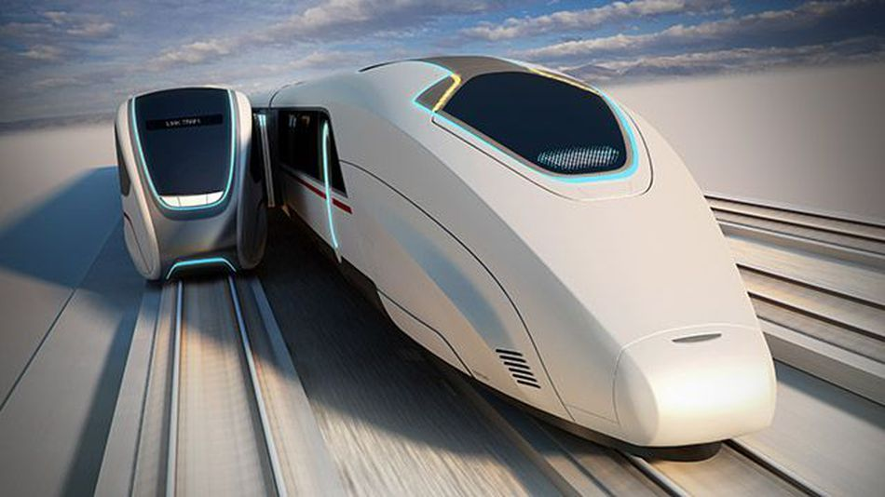
Boarding Passengers
Loading and unloading passengers can take as much time as travelling between destinations. Is there a way to get passengers on and off without slowing down the Hyperloop?
One Solution
Another Idea

Slide 23
Detachable Cars

Slide 24
Detachable Cars
What additional complications does this add?

Slide 25
Additional Complications

Slide 26
Additional Complications
Since the last car is dropped off at the next station, passengers who wish to get off would need to move back to that car before arriving at that station. Passengers who do not wish to get off would need to move forward.

Slide 27
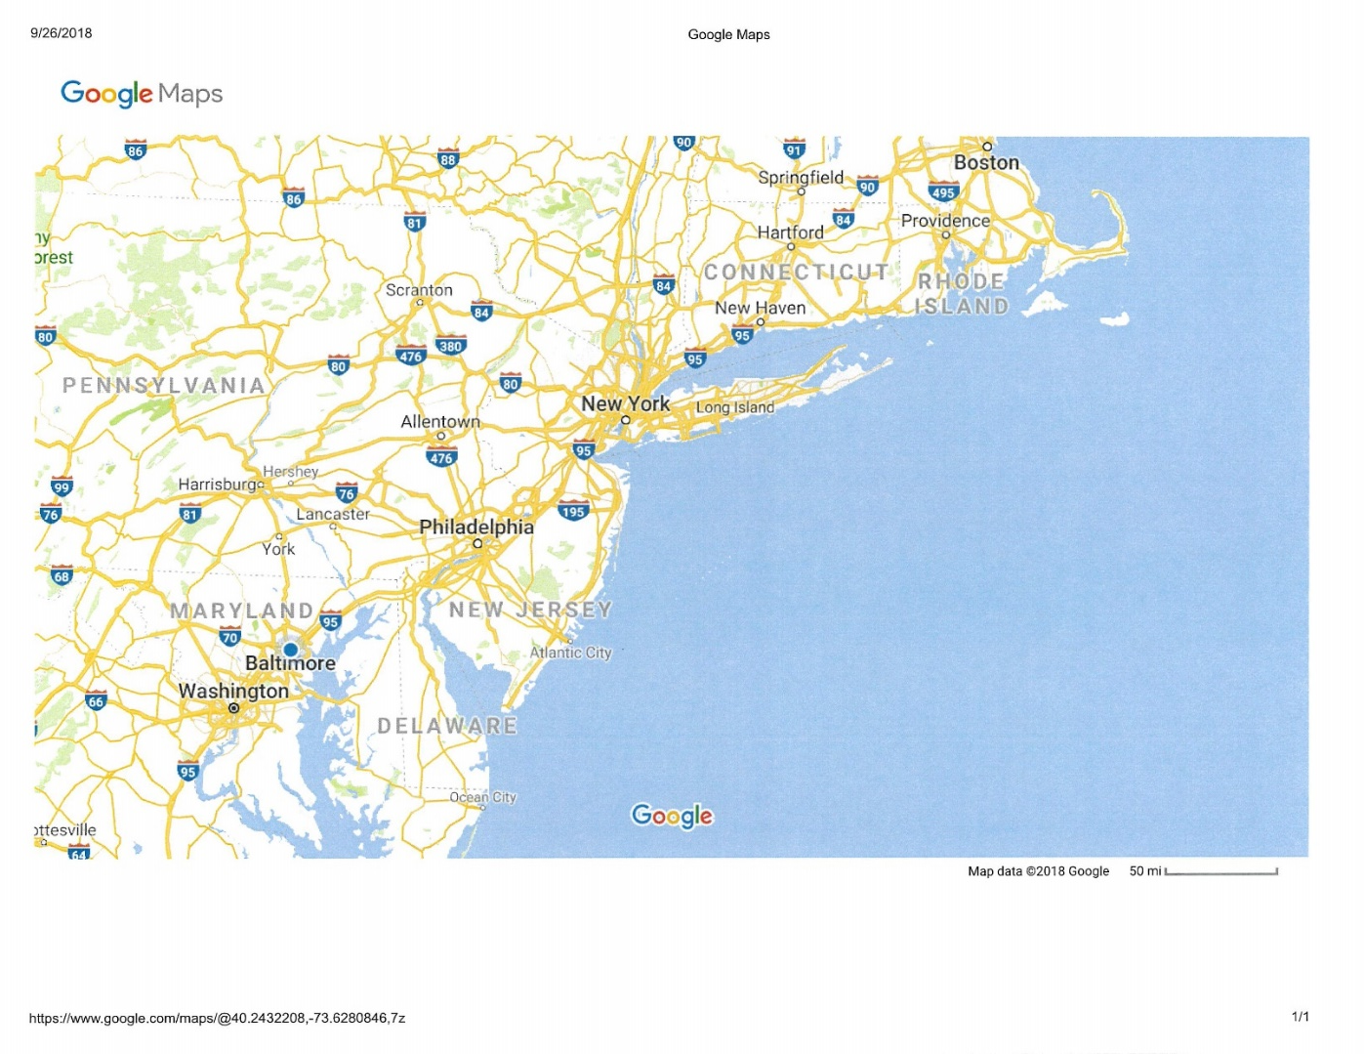
Second Example: Centripetal Acceleration
If the Hyperloop will travel between Boston and Washington, D.C., passing through New Haven, CT, New York, NY and Philadelphia, PA, it clearly cannot do this traveling in a straight line (see map). When the Hyperloop goes around a bend, there will be a centripetal acceleration. We need to ensure that this acceleration is not too large.
Using the map provided, estimate the “tightest” turn the Hyperloop will need to make to pass through each of these stations and the centripetal acceleration if the Hyperloop is traveling at 340 m/s. What do your numbers suggest about the feasibility of the Hyperloop design?

Slide 28
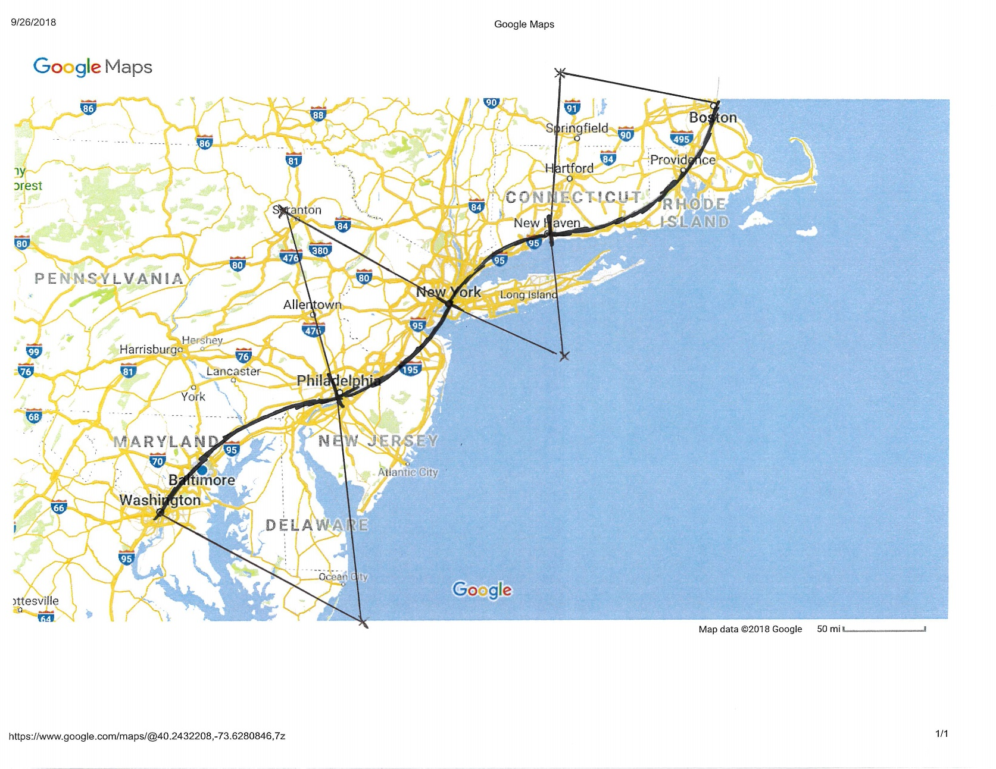
Second Example: Centripetal Acceleration
One way to draw the arcs is shown below. The arc between New Haven and New York seems to have the shortest radius of curvature. The radius length on the map is approximately 3.5 cm, so the actual radius is equal to
$R=\left(3.5 \text{cm}\right)\frac{50 \text{mi}}{2.3 \text{cm}}\frac{1610 \text{m}}{1 \text{mi}}=1.22×{10}^{5}\text{m}$
The centripetal acceleration is thus
$a_{c}={v^{2}}/R={{\left(340 \text{m}\text{/}\text{s}\right)}^{2}}/{\left(1.22×{10}^{5}\text{m} \right)}=0.94\text{m}\text{/}s^{2}$
So this seems within our acceptable value of acceleration.

Slide 29
Additional Hyperloop Examples:
Combination of Tangential and Centripetal Acceleration
Air Resistance
Work and Energy
Momentum / Collisions
Relativistic Time Dilation
Others….

Slide 30
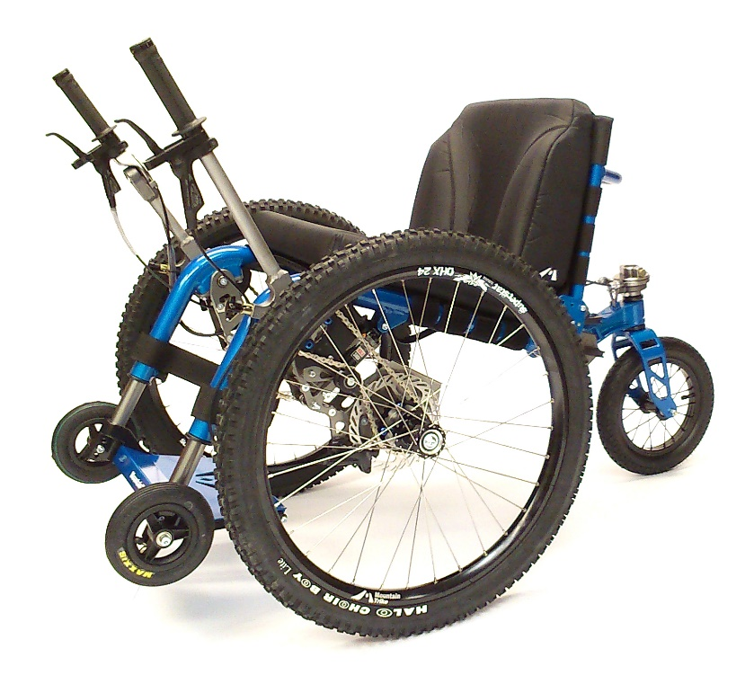
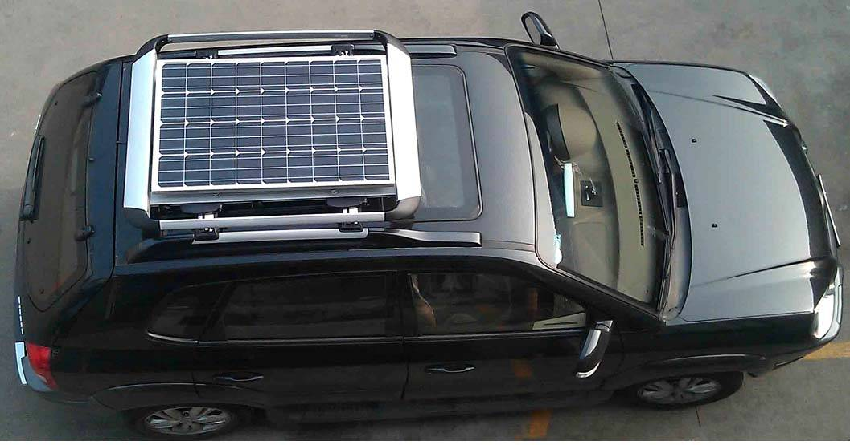
Other Examples:
The $1000 Question:
Would you invest $1000 ($100?) in my company to design, build and sell … ?
All-terrain wheelchair
Rooftop solar panels for a car
First consideration is Feasibility.
Your physics training makes you the expert!

Slide 31
Other interesting (?) ideas Would you invest your money?
Pyramid Power

Slide 32
Other interesting (?) ideas Would you invest your money?
Magnet Therapy

Slide 33
Other interesting ideas Would you invest your money?

Slide 34
Work, Energy and Power
Problem: Approximately, what is your change in gravitational potential energy when you climb a set of stairs?
ΔU_{g} = m g Δy
What is your mass?
m ≈ 75 kg
What is the height of a flight of stairs?
Look it up!
Δy ≈ 4 m
ΔU_{g} ≈ (75 kg)(10 N/kg)(4 m) = 3000 J

Slide 35
Work, Energy and Power
Problem: Approximately, how much work do you do when you climb a set of stairs?
W = ΔU_{g} ≈ 3000 J
Note that you do this work on yourself.

Slide 36
Work, Energy and Power
Problem: Approximately, what is your power output as you (leisurely) climb a set of stairs?
P = W/Δt
How long does it take to leisurely climb a set of steps?
Go do it!
Δt ≈ 15 s. (maybe!)
P ≈ (3000 J)/(15 s) = 200 W

Slide 37
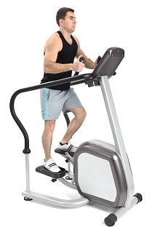
Work, Energy and Power
Problem: Suppose you “climb” the same distance on a stair-climbing machine. Is the work you do the same?
Seems like it must be.
Where does the energy go?
Energy is “lost” to thermal energy (the room warms up).
Can you think of any ways you could use what we have just learned?
Power output ≈ 200 Watts

Slide 38
Useful Applications of Human-generated Mechanical Power
Power electrical devices
Wait until next semester – electrical energy and power
One example: The Monstrosity Bike
Any other needs that could be addressed?
.
.
.

Slide 39
Useful Applications of Human-generated Mechanical Power
Sub-Saharan Africa
Where is the economy focused?
80% Sub-Saharan Africans are farmers
Tanzania – half GDP from farming and 80% of employment from farming
Uganda 85% of economic output based on farming
Irrigated agriculture has greatest potential impact

Slide 40
Useful Applications of Human-generated Mechanical Power
Could we develop a human-powered pump for irrigation in sub-Saharan Africa?
The thousand dollar question:
Would you invest $1000 in my company?
Initially, this is a feasibility question.

Slide 41
Feasibility of a Human-powered Irrigation Pump
What do we need to know/assume/estimate?
How much land (acres)?
How much water per acre?
How high must we lift the water?
How long can a person operate a pump?
How do we determine these things?
Make assumptions and/or use Google!

Slide 42
Feasibility of a Human-powered Irrigation Pump
How much land?
1 acre
How much water per acre?
Google it!
One approximation: 20,000 liters/day
How high must we lift the water?
10 m seems reasonable (from a well?)
How long can a person operate a pump?
Two hours?

Slide 43
Feasibility of a Human-powered Irrigation Pump
Let’s ask: How long does it take to pump enough water to irrigate one acre?

Slide 44
Feasibility of a Human-powered Irrigation Pump
One liter of water has a mass of 1 kg, so the work required to raise 20,000 liters 10 meters is
W = mgh = (20,000kg)(10N/kg)(10m)
= 2 x 10⁶ J
If we do 200 J of work every second, the required time is
t = (2 x 10⁶ J)/(200 J/s) = 10⁴ s = 2.8 hours
So this seems feasible.
Would you invest $1000?

Slide 45
Practicality of a Human-powered Irrigation Pump
Other mechanical issues:
Pump design
Friction (efficiency)
Materials
Locally available?
Repairs/spare parts
Cost
Can farmers afford it?
Can some profit be made?

Slide 46
Martin Fisher and Kickstart
“Poverty to Prosperity in Just One Season”
http://kickstart.org/
https://www.youtube.com/watch?v=PCPRgOGFElY
Notes:
Social Entrepreneur Martin Fisher and how he is using entrepreneurship throughout his company of Kickstart, formerly known as ApproTEC.

Slide 47
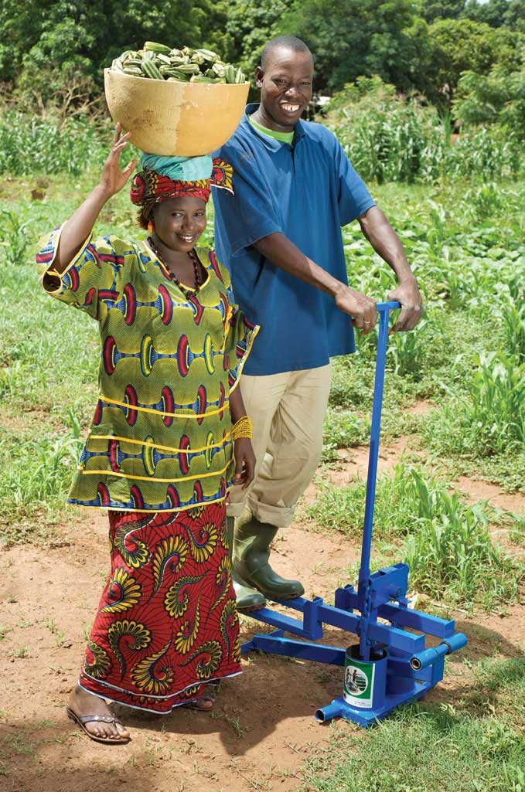
Kickstart’s Technology History: Super MoneyMaker (1998)
Dual piston micro-Irrigation pump
Can pump from 7m
below to 7m above
(or 200m horizontally)
Weighs 45 pounds
Waters 2 acres
Efforts similar to walking
Costs about $95
Notes:
Their next technology was the great success of the Super-MoneyMaker Pump in 1998.
This a small scale irrigation pump that uses human power to pump water from as deep as 23ft
The pump weights 45 pounds, can water 2 acres in a 6 hour days
Pump rate is about 1 liter/second

Slide 49
Kickstart and Martin Fisher Awards and Honors
Martin Fisher
Design News Magazine’s Engineer of the Year, 2008
$100,000 Lemelson MIT Award for Sustainability, 2008
OneWorld.net Person of the Year Award, 2008
Kickstart International
Drucker Award for Nonprofit Innovation, 2008

Slide 50
PH491/CS491/EG491 Technical Innovation and Entrepreneurship
Learn how to start with an idea and take it through to a finished, marketable product
Idea generation / Feasibility
Intellectual property
Business plan
Financing
Marketing
Patents

Slide 51
More Ideas:

