Slide 1



Slide 2


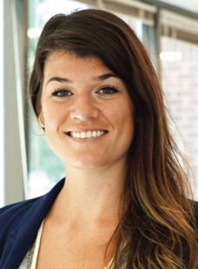
Maggie Seeds (she/her), B.S./B.A. , Business and Technology Consultant
Maggie found physics to be a natural path that “helped train her brain to think analytically.”
Currently, Maggie’s consultant role ranges from technical to strategic, falling anywhere in the process of raw materials making it all the way to finished, marketable products.
“Work on soft skills, especially communicating to different audiences, and never stop learning!”
Learn more: go.aps.org/deeperInSight

Slide 3
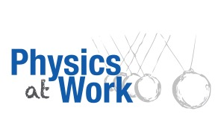

What Skills Does a Business and Technology Consultant Use?
Critical thinking and creativity
Collaboration and team-work
Business strategy and marketing
Data analytics and visualization
Research
Communication
Learn more: go.aps.org/deeperInSight

Slide 4
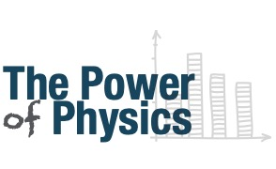

Most Physics Bachelors in the Private
Sector Make Between $40-70K
aip.org/statistics
Learn more: go.aps.org/deeperInSight

Slide 5
Attending APS March or April Meeting?
Find your community through the Future of Physics Days events for undergraduates:
Network with physicists from academia and industry
Attend a grad school fair or panel
Discover physics career options
Receive a free t-shirt!
You may be eligible for a travel award!
Check out: go.aps.org/fpd
Learn more: go.aps.org/deeperInSight

Slide 6
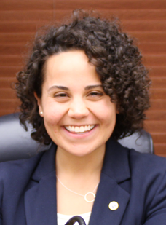
Giavanna Jadick (she/her), AIP Mather Policy Intern, Summer 2019
Double majoring in physics and political science, Giavanna was able to apply her skills from both fields this summer when interning with the U.S. House Committee on Space and Science.
Since she also enjoys teaching immensely, after graduating, Giavanna plans to continue combining her passions for problem-solving, policy, and communicating science in novel ways.
Learn more: go.aps.org/deeperInSight

Slide 7
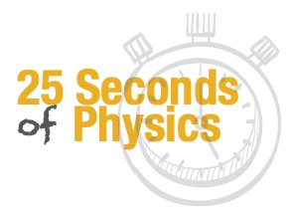
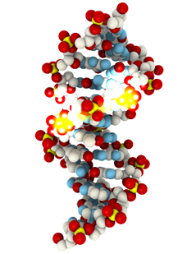

Can DNA Conduct Electricity?
For years, scientists have wondered if DNA can conduct electricity - some researchers thought it to be a superconductor, while others say it’s an insulator!
For the first time ever, evidence has shown charge transport within a DNA strand. Could this one day lead to tiny DNA-sized wires and change technology forever?
Tatiana Latychevskaia, University of Zurich
Learn more: go.aps.org/deeperInSight

Slide 8
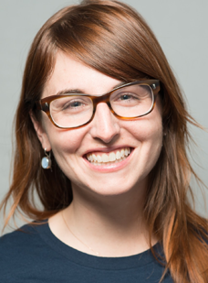
Jessica Kirkpatrick (she/her), PhD, Director of Data Science and Digital Exploration
Though Jessica often struggled in courses due to a learning disability, she discovered her talent for physics in high school and
got a PhD.
Currently, Jessica uses machine learning to predict locations with new sources of battery minerals. Her long-term goal is to start a company to solve social problems.
“Learn to build projects with code, and build a strong network.”
Learn more: go.aps.org/deeperInSight

Slide 9

What Skills Does a Data Scientist Use?
Building systems (data engineering)
Using large data sets for decision making
Data modeling
Machine learning
Finding creative solutions to problems
Effective communication with multiple teams - marketing, technical, etc.
Learn more: go.aps.org/deeperInSight

Slide 10
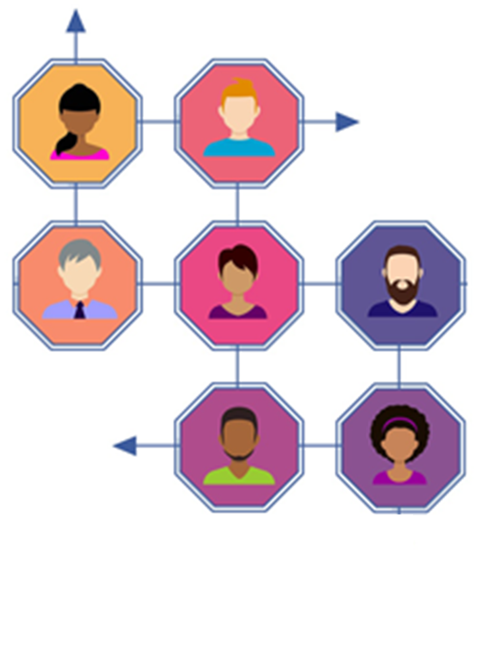
Explore Our Online Job Board To:
Search for positions by location, physics field, job sector and more!
Browse through job postings specifically for physics degree holders.
Store your resume, cover letters, and other materials on the site.
Apply for positions directly through the job center!
Visit: careers.aps.org
Learn more: go.aps.org/deeperInSight

Slide 11
What Can Scientists learn From Eels About Generating Electricity Underwater?
Eels have cells containing high and low concentrations of charged potassium and sodium ions, respectively. When a neurotransmitter signals to the membrane to let the ions pass through, it gives rise to an electric current, generating up to 600 volts!
A group of researchers at Georgia Tech are attempting to mimic the phenomenon to make underwater wearable tech.
Zou, Y. et al.
Learn more: go.aps.org/deeperInSight

Slide 12
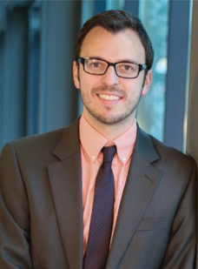
Nathan Swift (he/him), M.S., Startup Co-Founder & COO
Nathan liked physics because he was better at deriving things than memorization. After his B.S. and a few years in industry, he got a Masters in physics entrepreneurship.
Combining his passions for physics and business, Nathan co-founded a startup called Hedgemon that makes sports safety gear, car seats, and other products inspired by the physics of hedgehogs!
Learn more: go.aps.org/deeperInSight

Slide 13
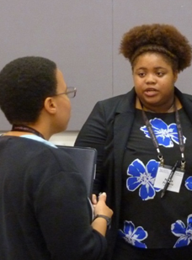
Join the APS National Mentoring Community (NMC)
NMC supports underrepresented minority students pursuing a physics bachelors degree by providing:
Mentorship from multiple mentors within
or outside their institution
One-year free student membership in APS
Information on resources and opportunities
Up to $1500 in emergency funding through the BEAM fund
For more info, email: nmc@aps.org
Learn more: go.aps.org/deeperInSight

Slide 14
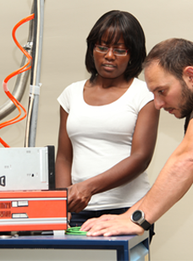
Most Potentially Permanent Jobs for Physics PhDs Are Outside of Academia
Employment Field of New Physics PhDs (2015 & 2016)
aip.org/statistics
Learn more: go.aps.org/deeperInSight

